Slide 1

QuickConnect

Slide 2
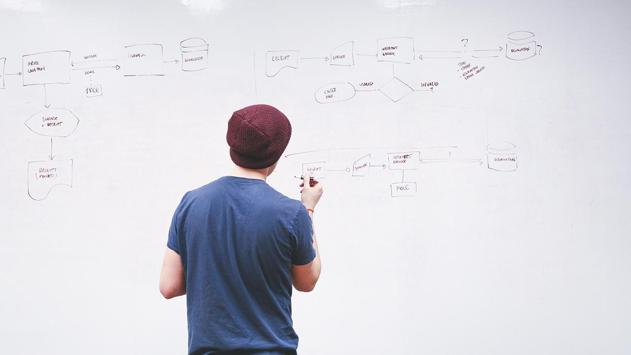
Prepared by
Viraj Sanghani
Rahul Panchal
Masira Mansuri

Slide 3
proposed system
An all-in-one platform to build and launch conversational chatbots with less coding.
A chatbot is software that simulates human-like conversations with users via text messages on chat. Its key task is to help users by providing answers to their questions.
Users in both business-to-consumer (B2C) and business-to-business (B2B) environments increasingly use chatbot virtual assistants to handle simple tasks.
Adding chatbot assistants reduces overhead costs, uses support staff time better and enables organizations to provide customer service during hours when live agents aren't available.

Slide 4
Group Details
Student Name | Roll No
Viraj sanghani | 215690694057
Rahul Panchal | 215690694028
Masira Mansuri | 215690694008

Slide 5
Tools and Technology used :`
Project Title | QuickConnect
Technology | MongoDB, Express, React, Node, Socket.io
Supporting tools | Visual Studio Code, Microsoft PowerPoint, Draw.io
Team-members | 3

Slide 6
Diagrams

Slide 7
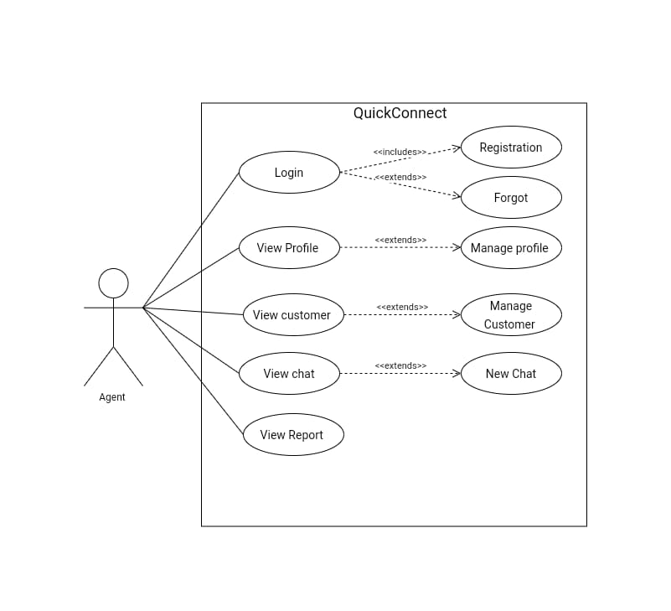
Use Case Diagram for agent:-

Slide 8
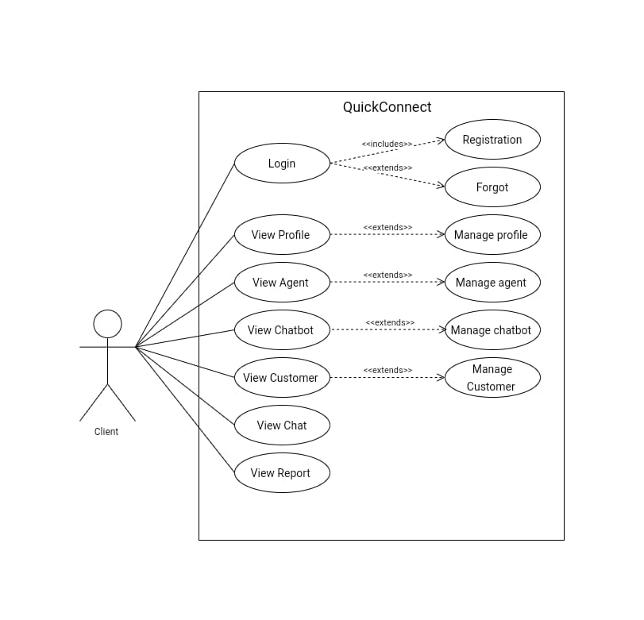
Use Case Diagram for client:-

Slide 9
Activity Diagrams

Slide 10
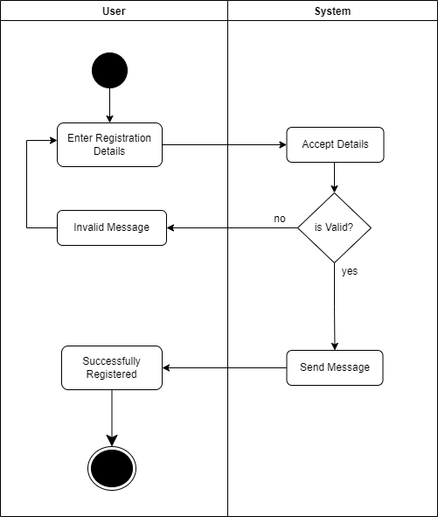
Registration:-

Slide 11
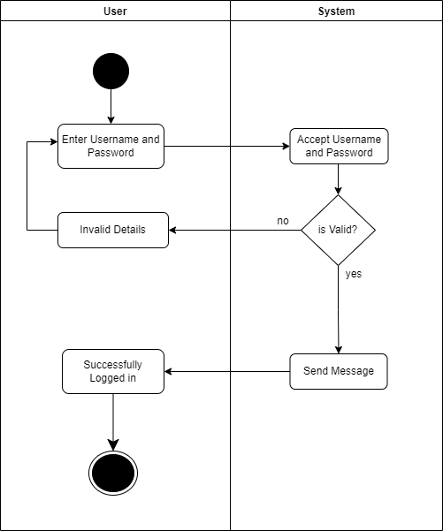
Login:-

Slide 12
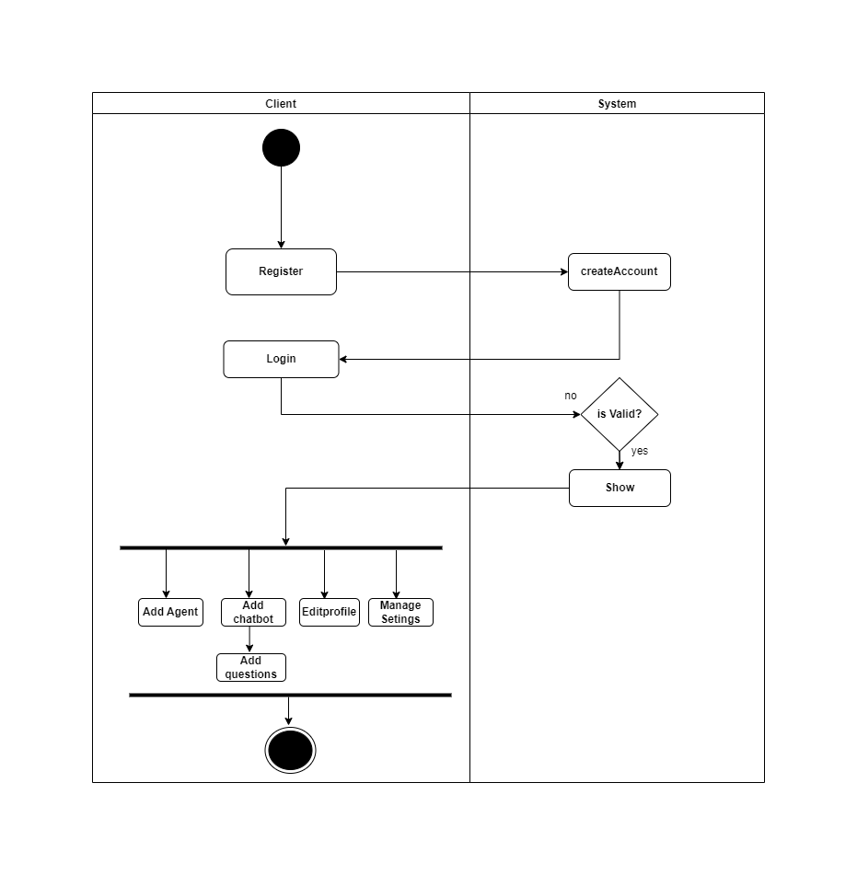
Client:-

Slide 13

Agent:-

Slide 14
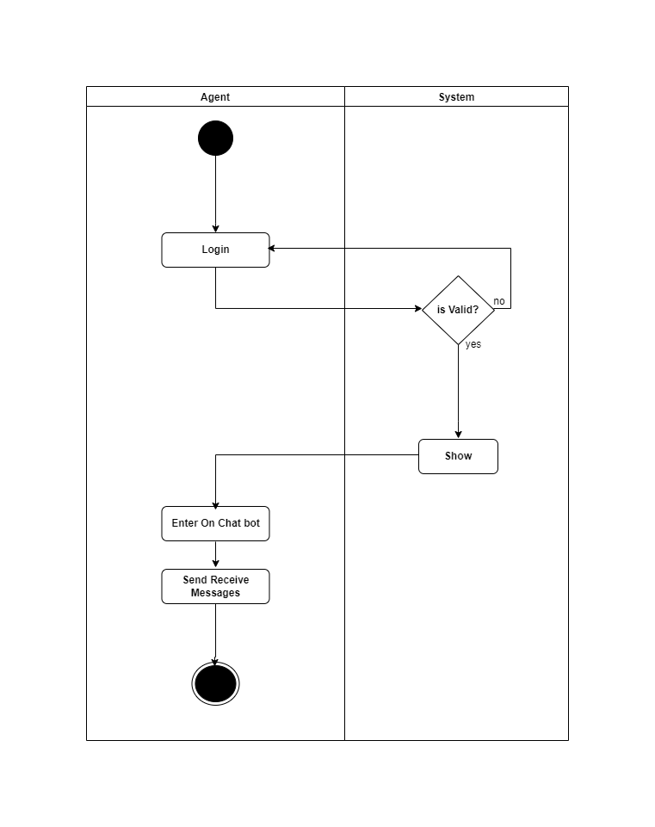
Chat:-

Slide 15
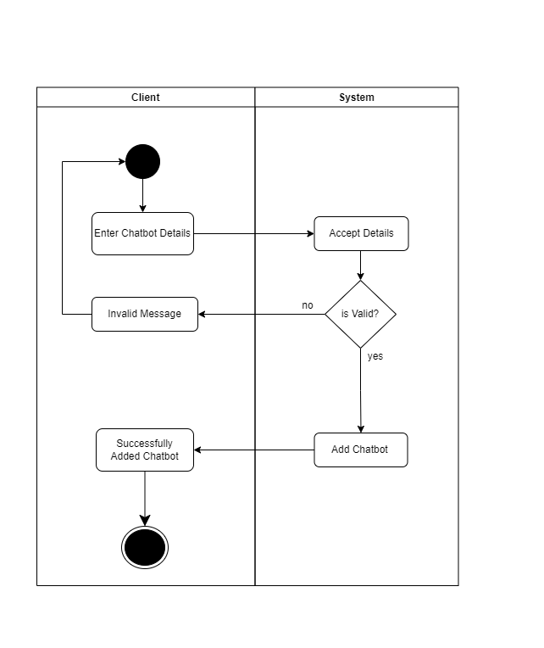
Chatbot:-

Slide 16
Sequence Diagrams

Slide 17
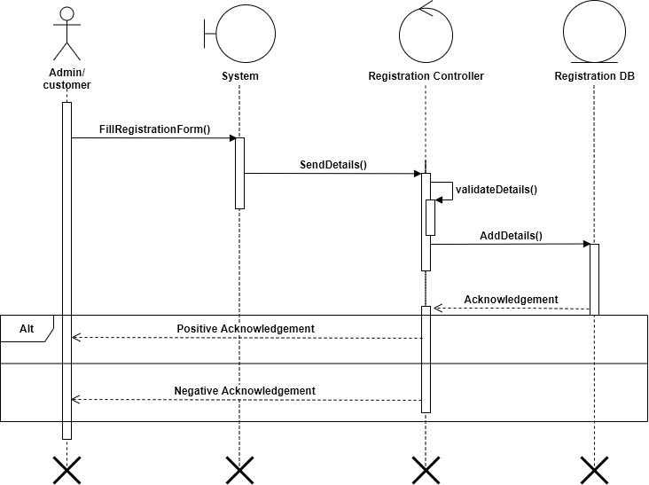
Registration:-

Slide 18
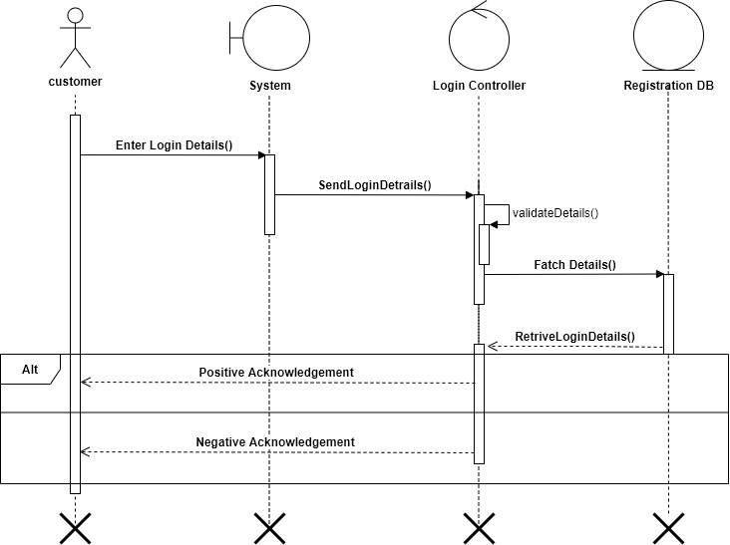
Login:-

Slide 19
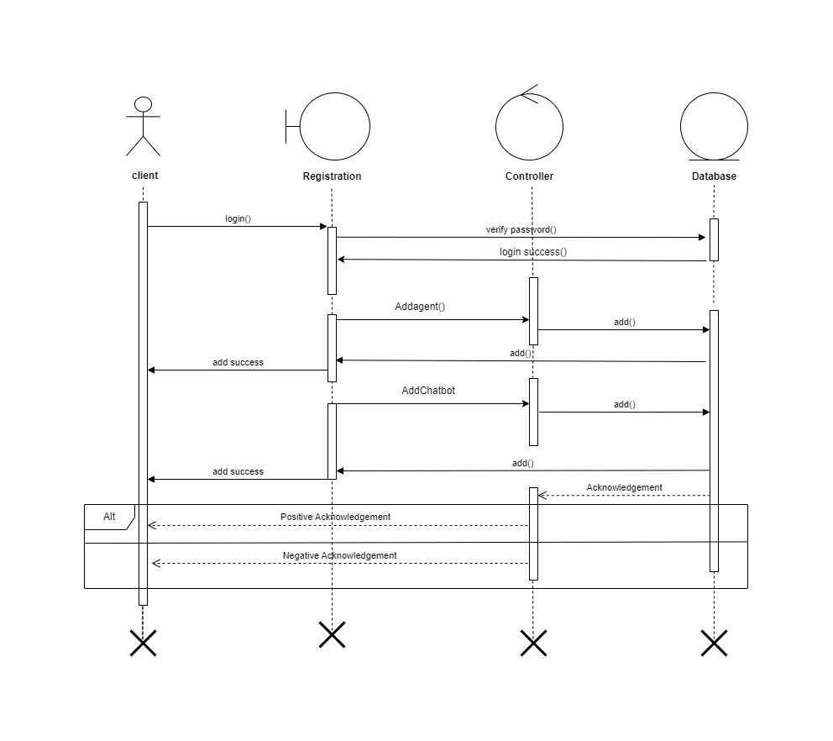
Client:-

Slide 20
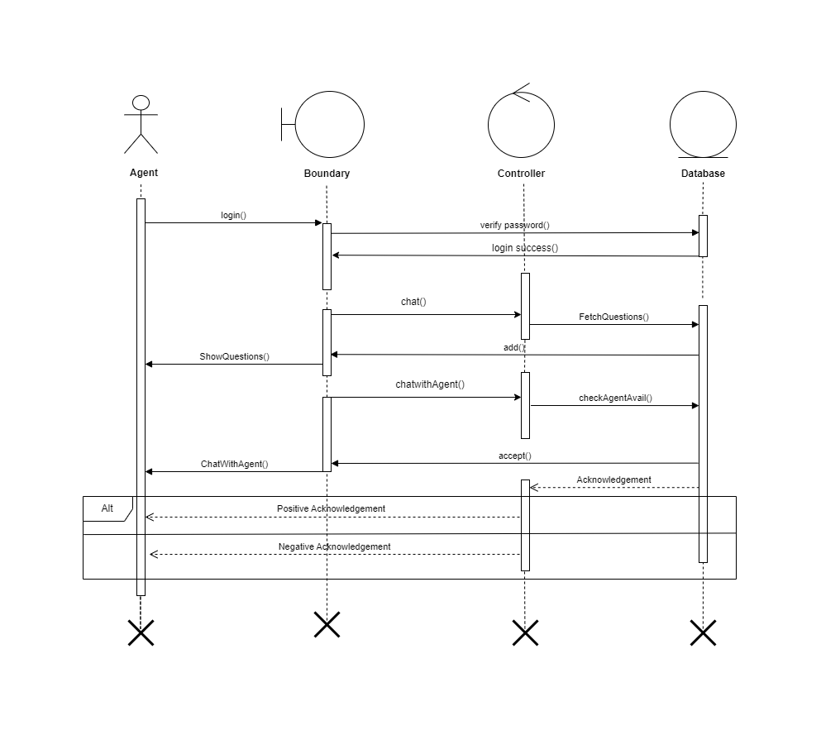
Agent:-

Slide 21
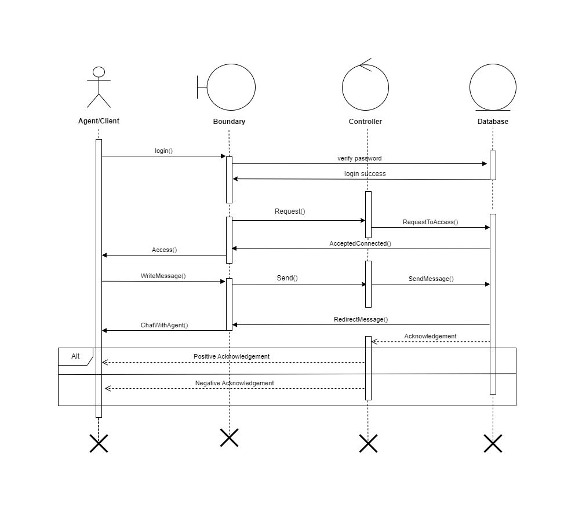
Chat:-

Slide 22
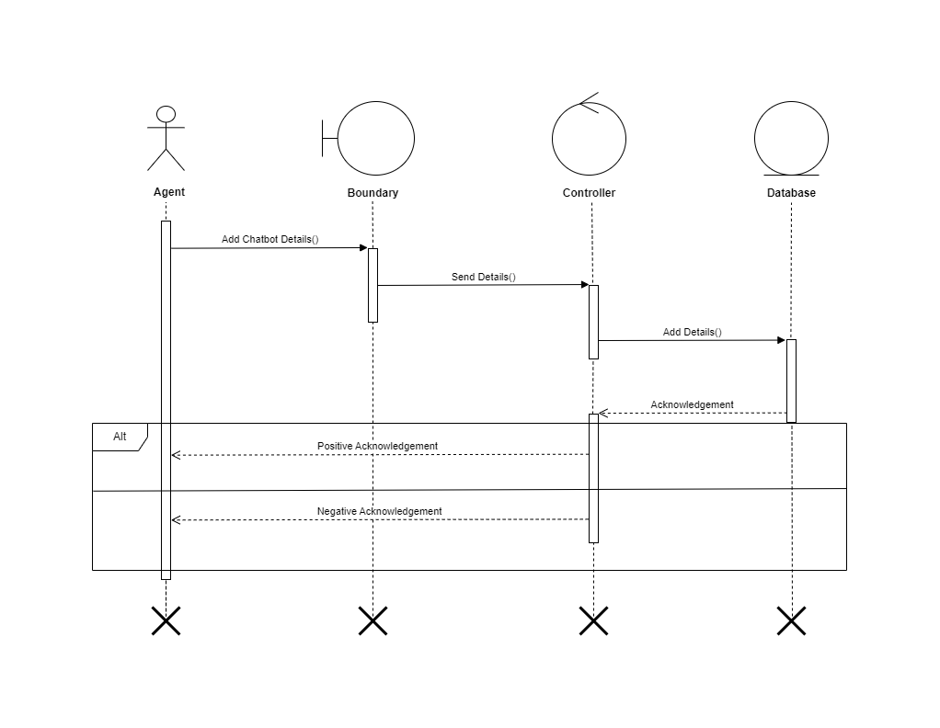
Chatbot:-

Slide 23
Class Diagram

Slide 24
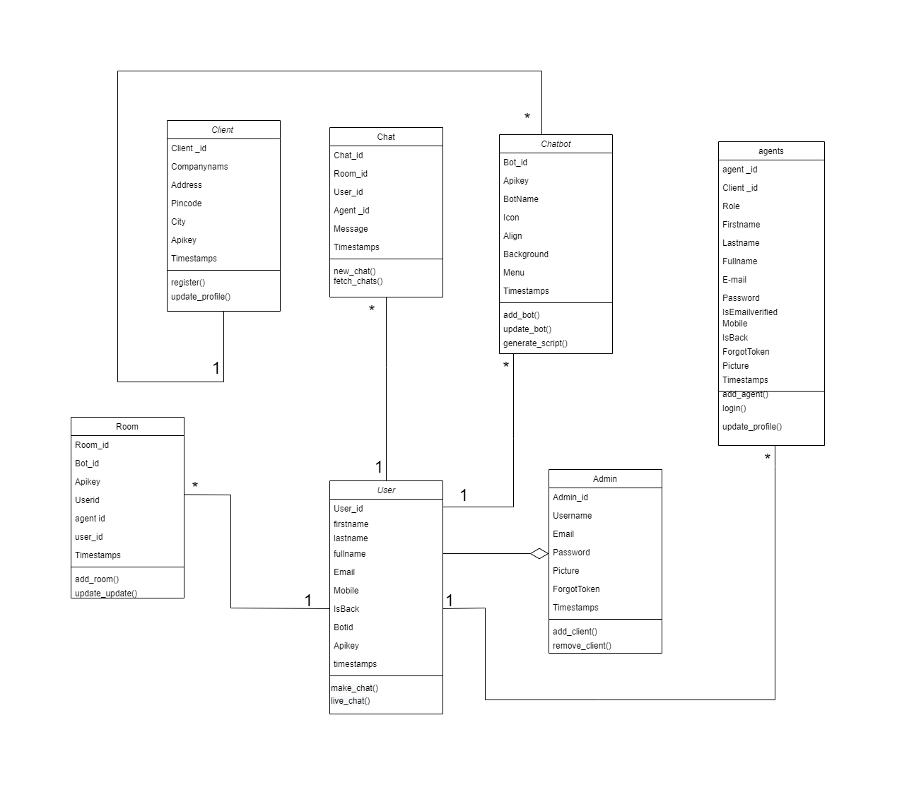
Class Diagram

Slide 25
Data Dictionary

Slide 26
Admin:-
Field Name | Datatype (Size) | Constraints | Description
Admin_Id | Number (10) | Primary Key / Auto Inc. | Auto Generated by the Database admin
user_name | Varchar (20) | Not Null | Name of user
Email_id | Varchar (48) | Not Null | It indicates the email Address of admin
Password | Varchar (10) | Not Null | It indicates admin password
Picture | Varchar(10) | Not Null | It indicates picture of admin
ForgotToken | Varchar(30) | Not Null | It indicates forgot token
Timestamps | Enum("T","F") | Not Null | It indicate time stamp

Slide 27
Client:-
Field Name | Datatype (Size) | Constraints | Description
Client_id | Number(10) | Primary Key / Auto Inc. | Auto Generated by the Database user.
Company_name | Varchar (30) | Not Null | Company Name of client
Address | Text | Not Null | It indicates the address of client
Pincode | Number (10) | Not Null | It indicates pincode of client
City | Varchar(30) | Not Null | It indicates city of client
Api_key | Number(10) | Not null | It generate api key

Slide 28
Agent:-
Field Name | Datatype (Size) | Constraints | Description
Agent_id | Number(10) | Primary Key / Auto Inc. | Auto Generated by the Database User.
Client_id | Number (10) | Not Null | It indicates client id
Role | Varchar (20) | Not Null | It indicates role of agent
First_name | Varchar(10) | Not Null | It indicates first name of agent
Last_name | Varchar(10) | Not Null | It indicates last name of board
Email_id | Varchar(30) | Not Null | It indicates emailid of board
Password | Varchar(30) | Not Null | It indicates upd Password of board
IsEmailverified | Enum("T","F") | Not Null | Verify email
mobile | Number(10) | Not Null | It indicates mobile number
isBlock | Enum(“T”,”F”) | Not Null | It indicates isBlock or not
forgotToken | Varchar(30) | Not Null | It indicates forgottoken
picture | Varchar(30) | Not Null | It indicates picture of agent

Slide 29
Chatbot :-
Field Name | Datatype (Size) | Constraints | Description
Bot_id | Number (10) | Primary Key / Auto Inc. | Auto Generated by the Database.
Api_key | Varchar (40) | Not Null | It generates api key
Icon | Varchar (40) | Not Null | It indicates icon of chatbot
align | Varchar(30) | Not Null | It indicates the align of chatbot
Background | Varchar(30) | Not Null | It indicates background of chatbot
Menu | Number(10) | Not Null | Fetch data from chatbot
Timestamps | Enum("T","F") | Not Null | It indicates time

Slide 30
Chat:-
Field Name | Datatype (Size) | Constraints | Description
Chat_id | Number (10) | Primary Key / Auto Inc. | Auto Generated by the Database user.
Room_id | Number (10) | Not Null | Auto
User_id | Number (10) | F.k | Fetch data from user table
Agent_id | Number(10) | F.K | Fetch data from agent table
Message | Text | Not Null | It indicates message of chat
Timestamps | Enum("T","F") | Not Null | It indicates the time of chat

Slide 31
Room:-
Field Name | Datatype (Size) | Constraints | Description
Room_id | Number (10) | Primary Key / Auto Inc. | Auto Generated by the Database user.
Bot_id | Number(10) | F.k | Fetch data from chatbot table
Api_key | Varchar (40) | Not Numl
User_id | Number(10) | F.k | Fetch data from user table
Agent_id | Number (10) | F.k | Fetch data from agent table

Slide 32
Comment:-
Field Name | Datatype (Size) | Constraints | Description
Comment_id | Number(10) | Not Null | Auto Generated by Database User.
User_id | Number(30) | F,k | Fetch data from user table
Card_id | Number(10) | F.k | Fetch data from card table
Message | Text | Not Null | It indicates the message
Created_at | Varchar(30) | Not Null | It indicates created time of comment.

Slide 33
User:-
Field Name | Datatype (Size) | Constraints | Description
User_id | Number (10) | F.K | Fetch databfrom user table
First_name | Varchar (20) | Not Null | It indicates first_name of user
Last_name | Varchar (20) | Not Null | It indicates the last name of user
Full_name | Varchar (20) | Not Null | It indicates the full name of user
Email_id | Varchar (10) | Not Null | It indicates email of user
Mobile | Number(10) | Not Null | It indicates mobile number of user
IsBlock | Enum("T","F") | Not Null | It check
Bot_id | Number (10) | F.k | Fetch data from the chatbot table

Slide 34
Screenshot

Slide 35
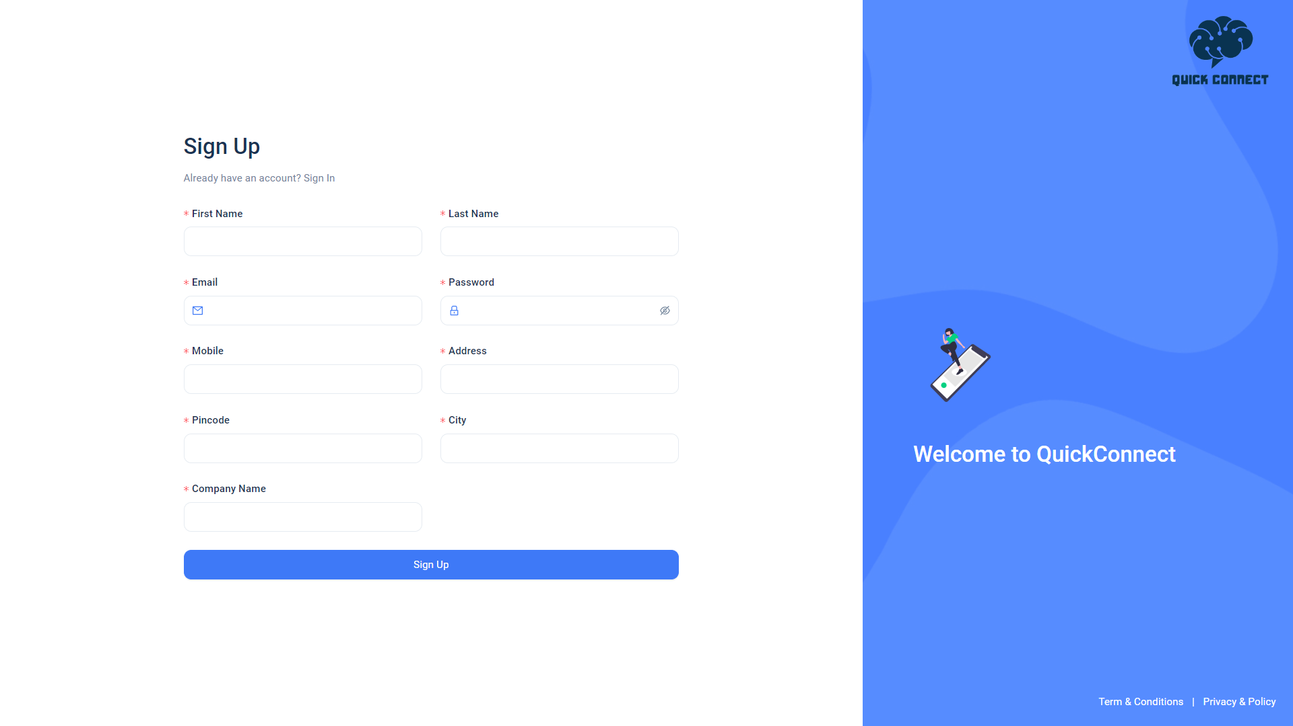
SignUp:-

Slide 36
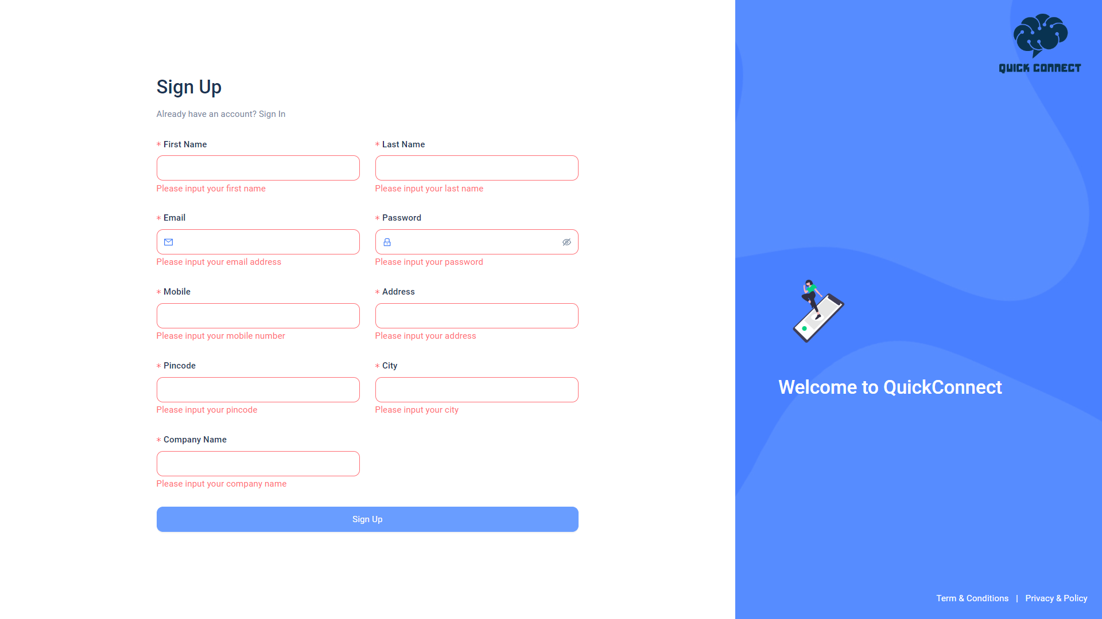
SignUp Validation:-

Slide 37
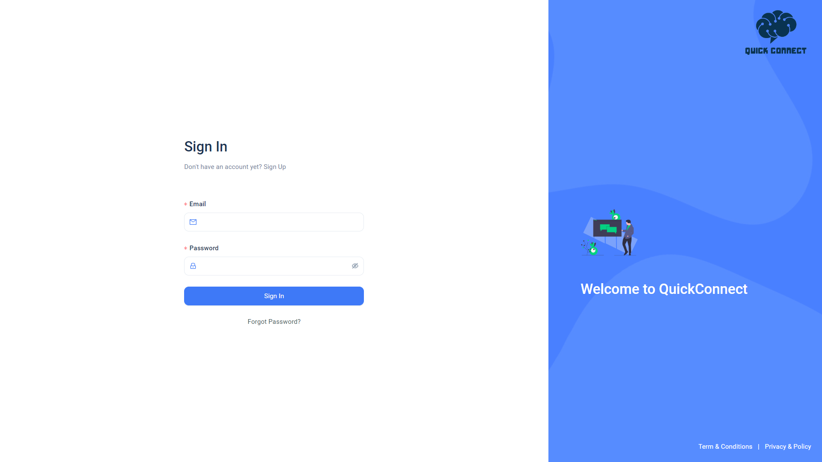
Sign In:-

Slide 38
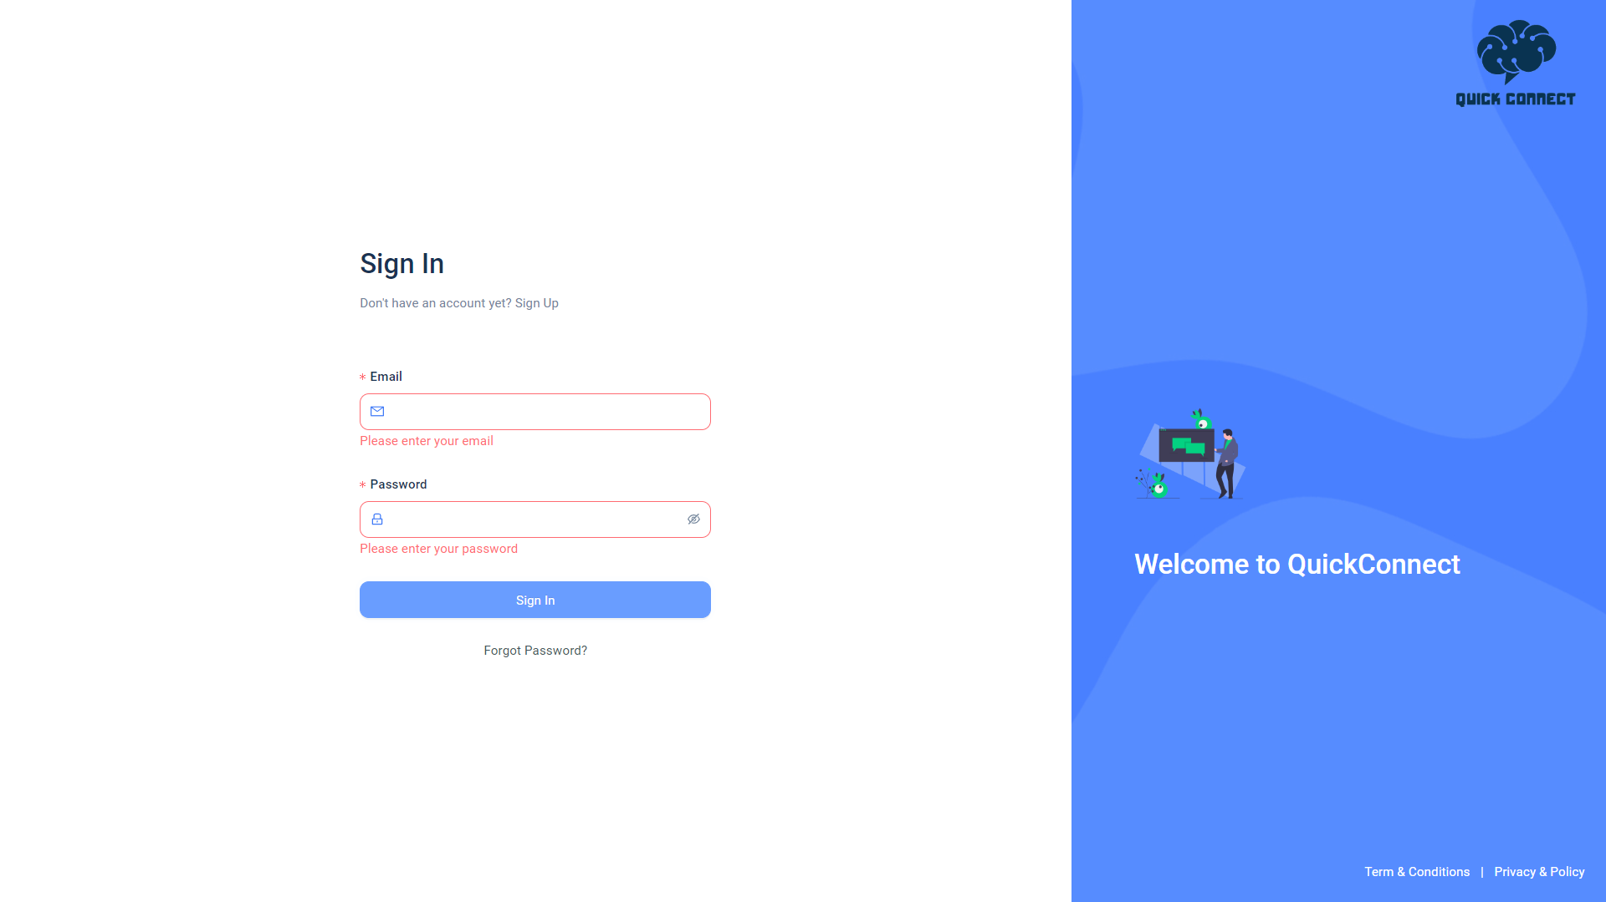
Sign In Validation:-

Slide 39
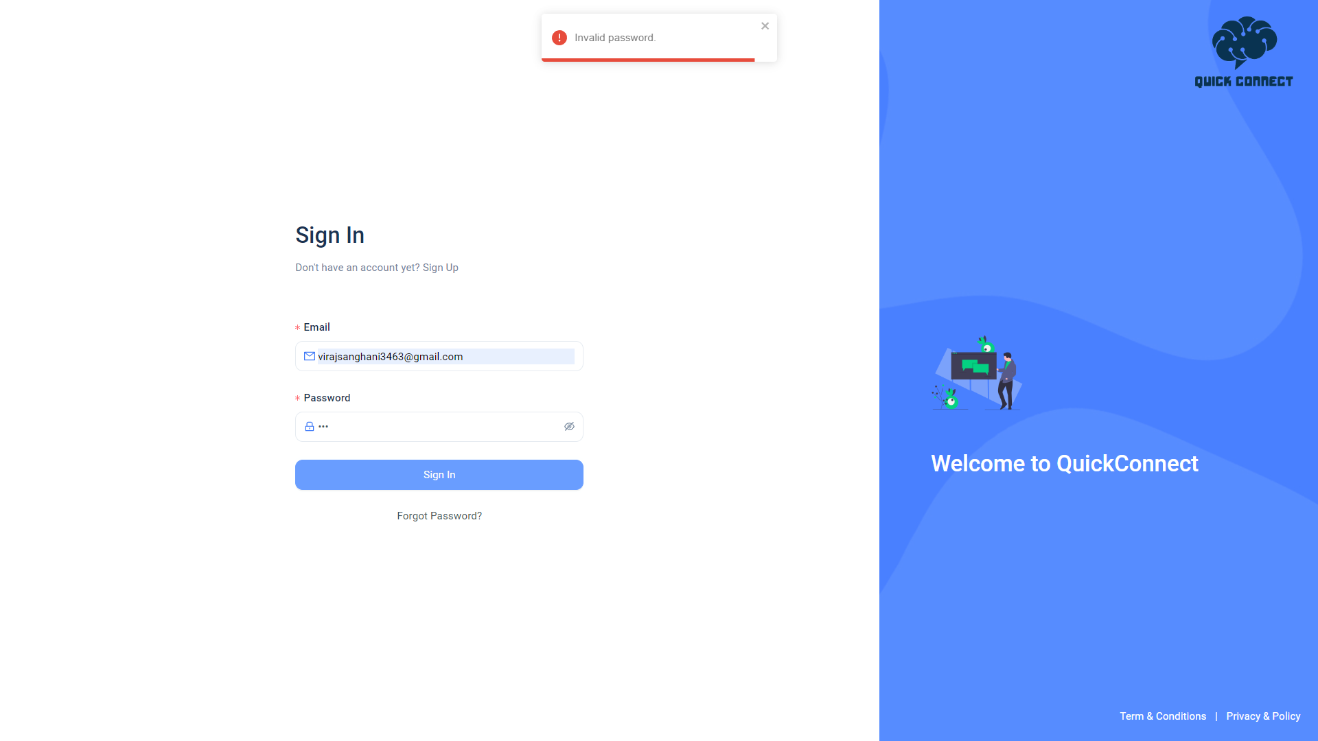
Sign In:-

Slide 40
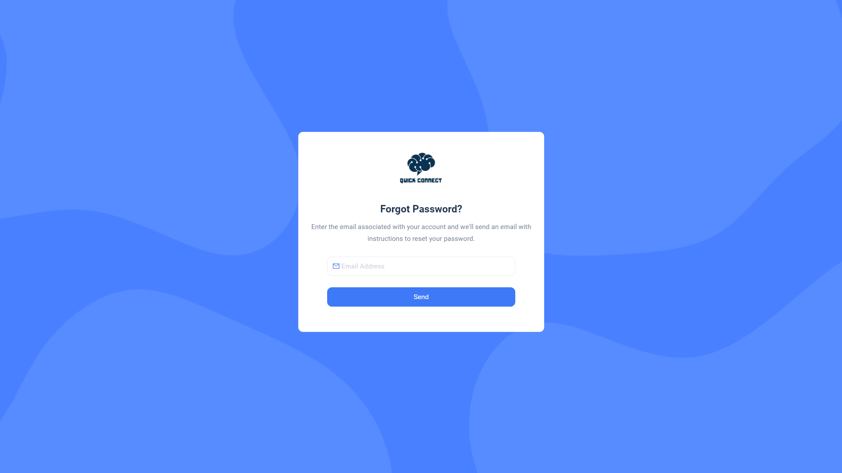
Forgot Password:-

Slide 41
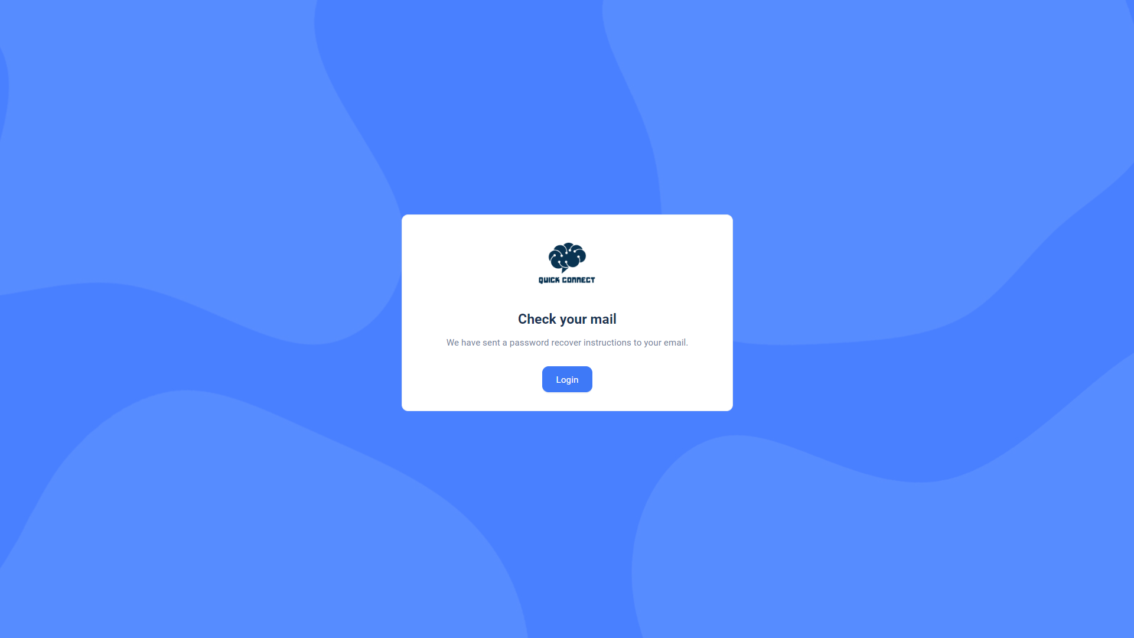
Forgot Password :-

Slide 42
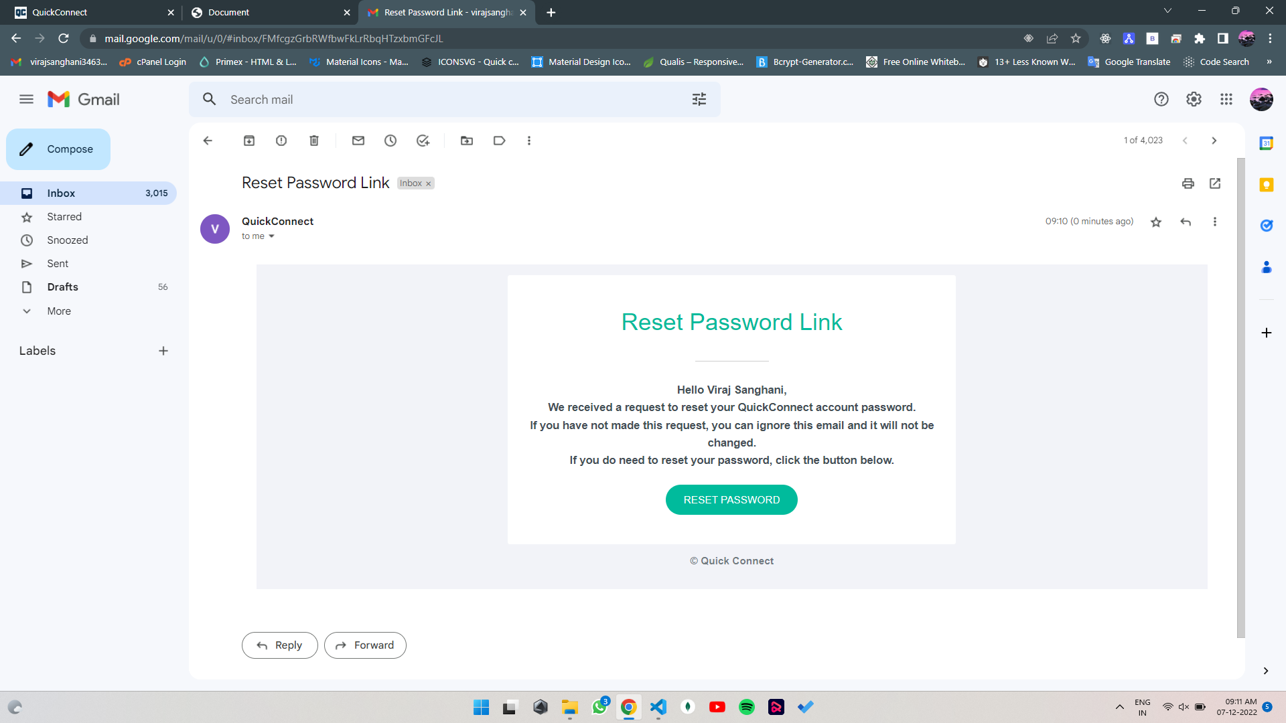
Reset Password Link:-

Slide 43
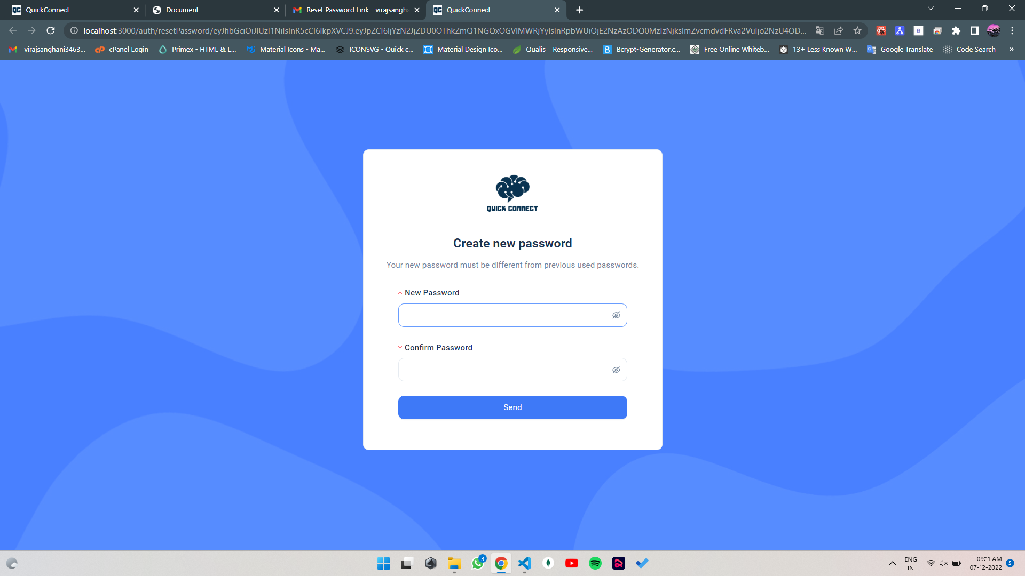
Create new Password:-

Slide 44
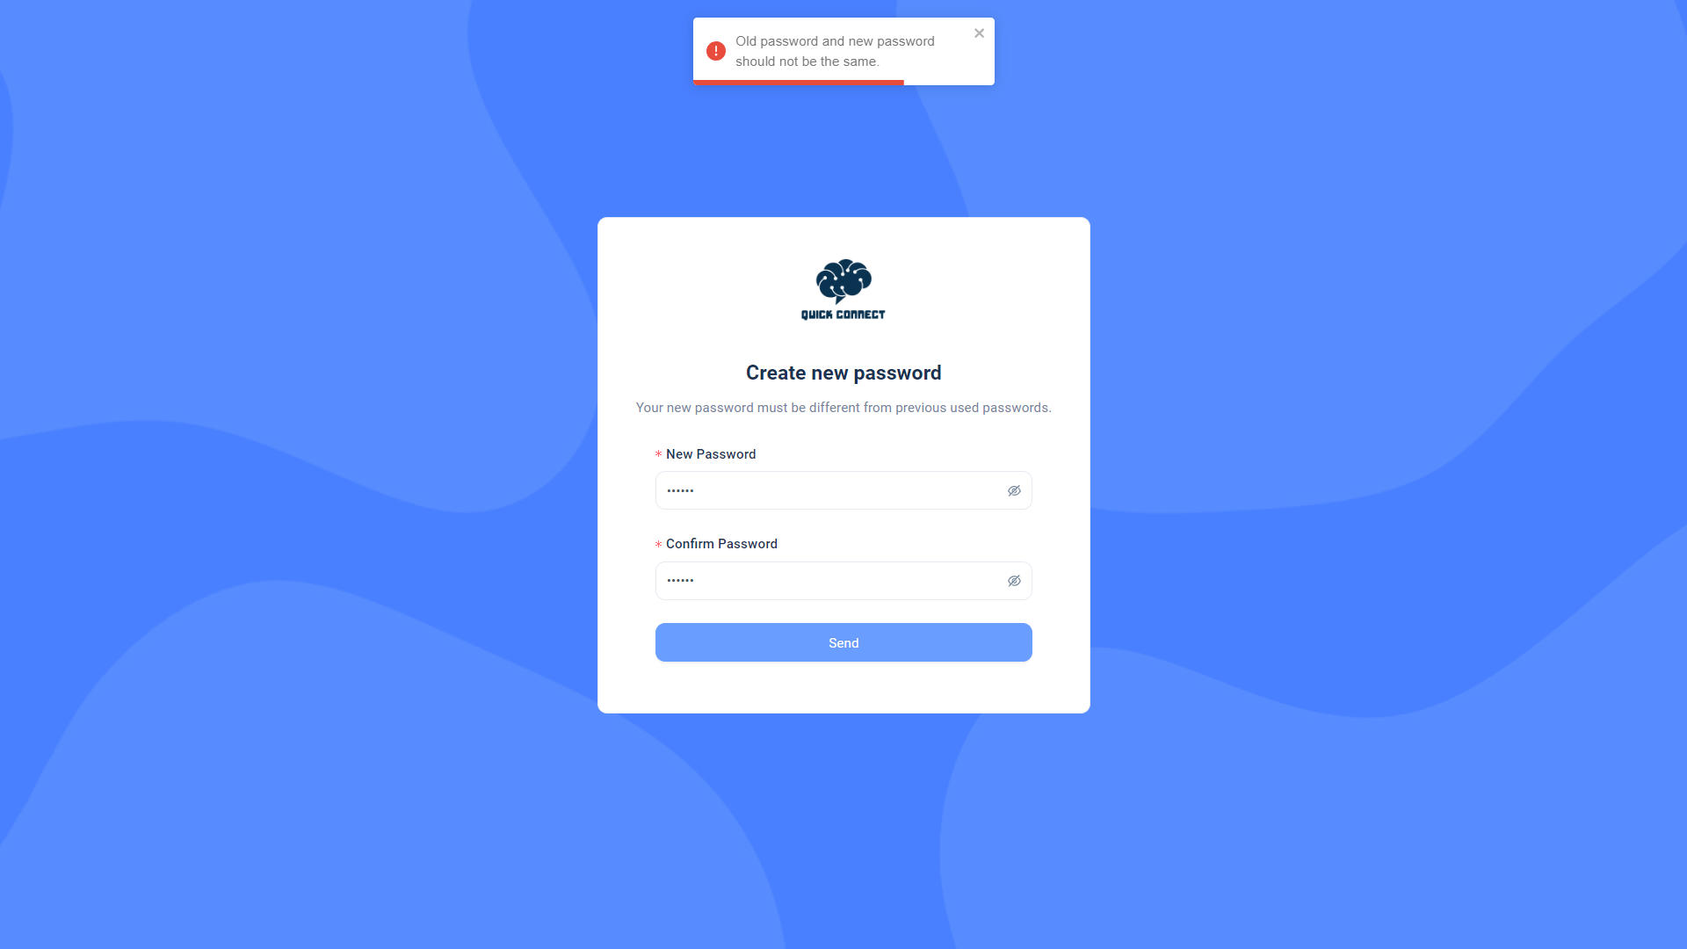
Create new Password :-

Slide 45
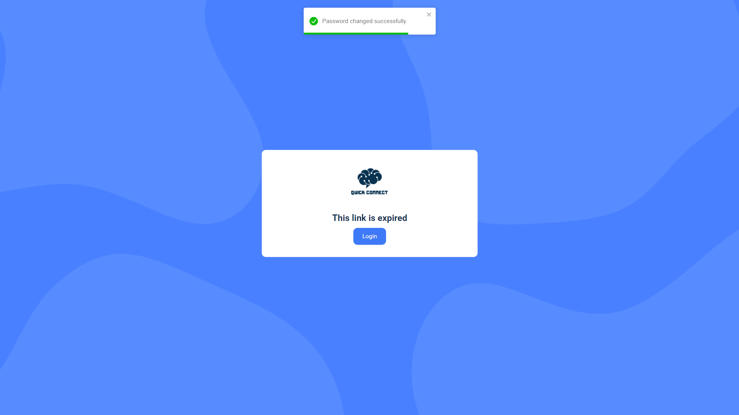
Password change Success :-

Slide 46
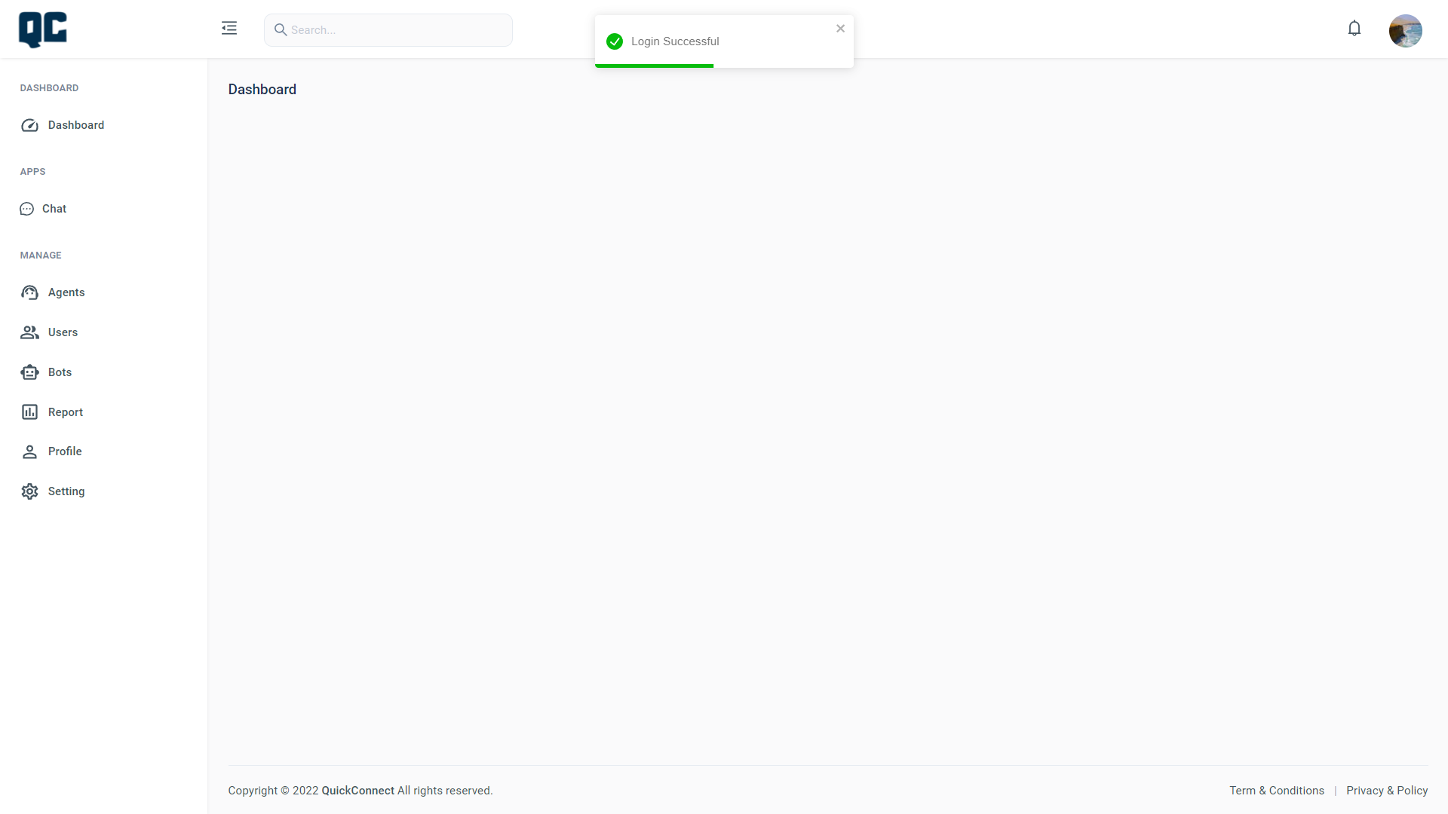
Admin:-

Slide 47
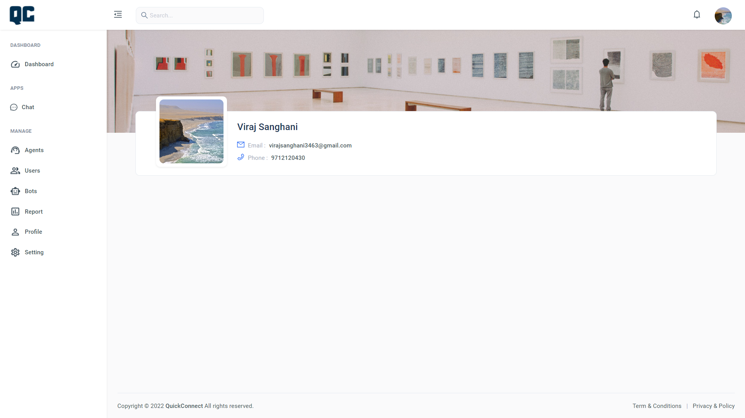
Admin Profile:-

Slide 48
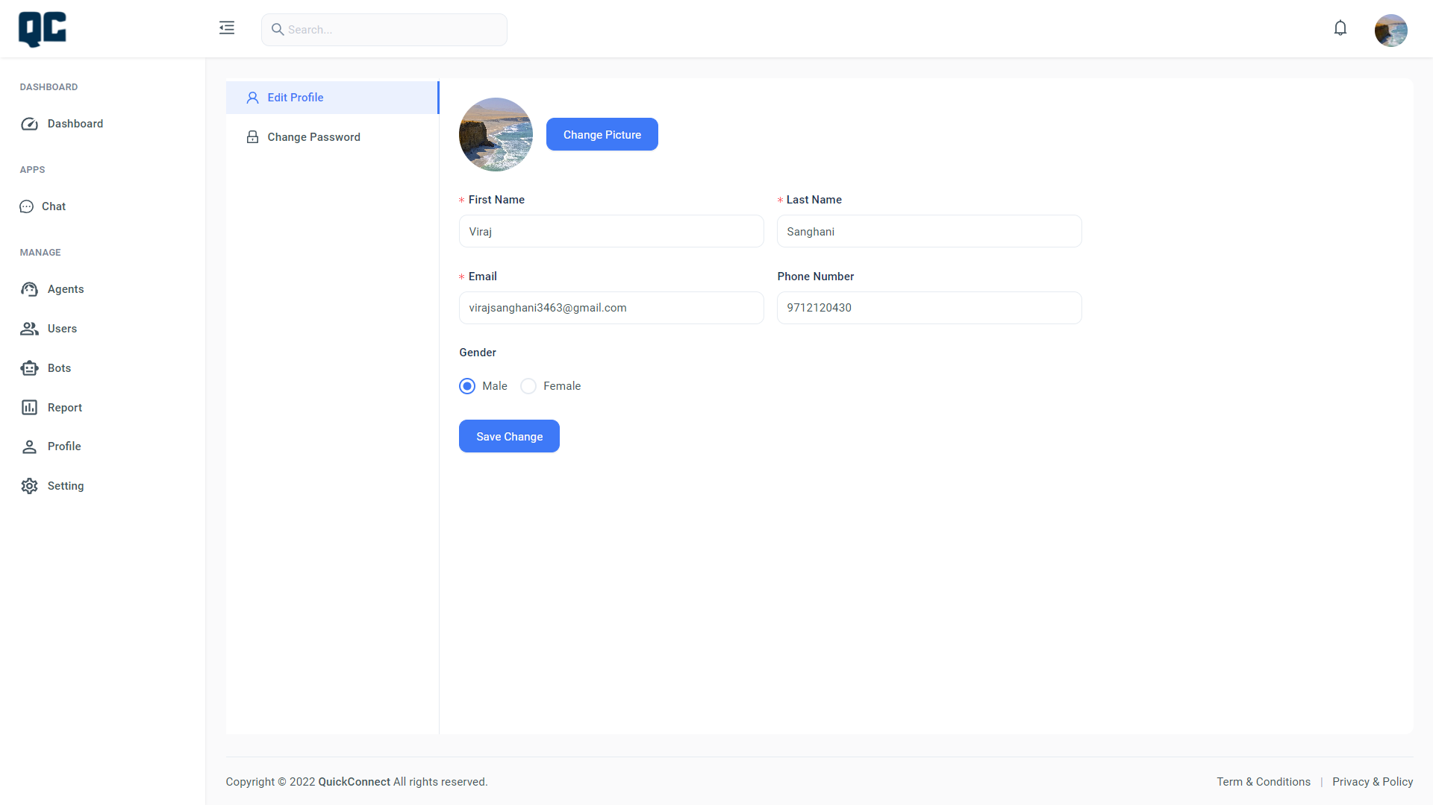
Edit Profile:-

Slide 49
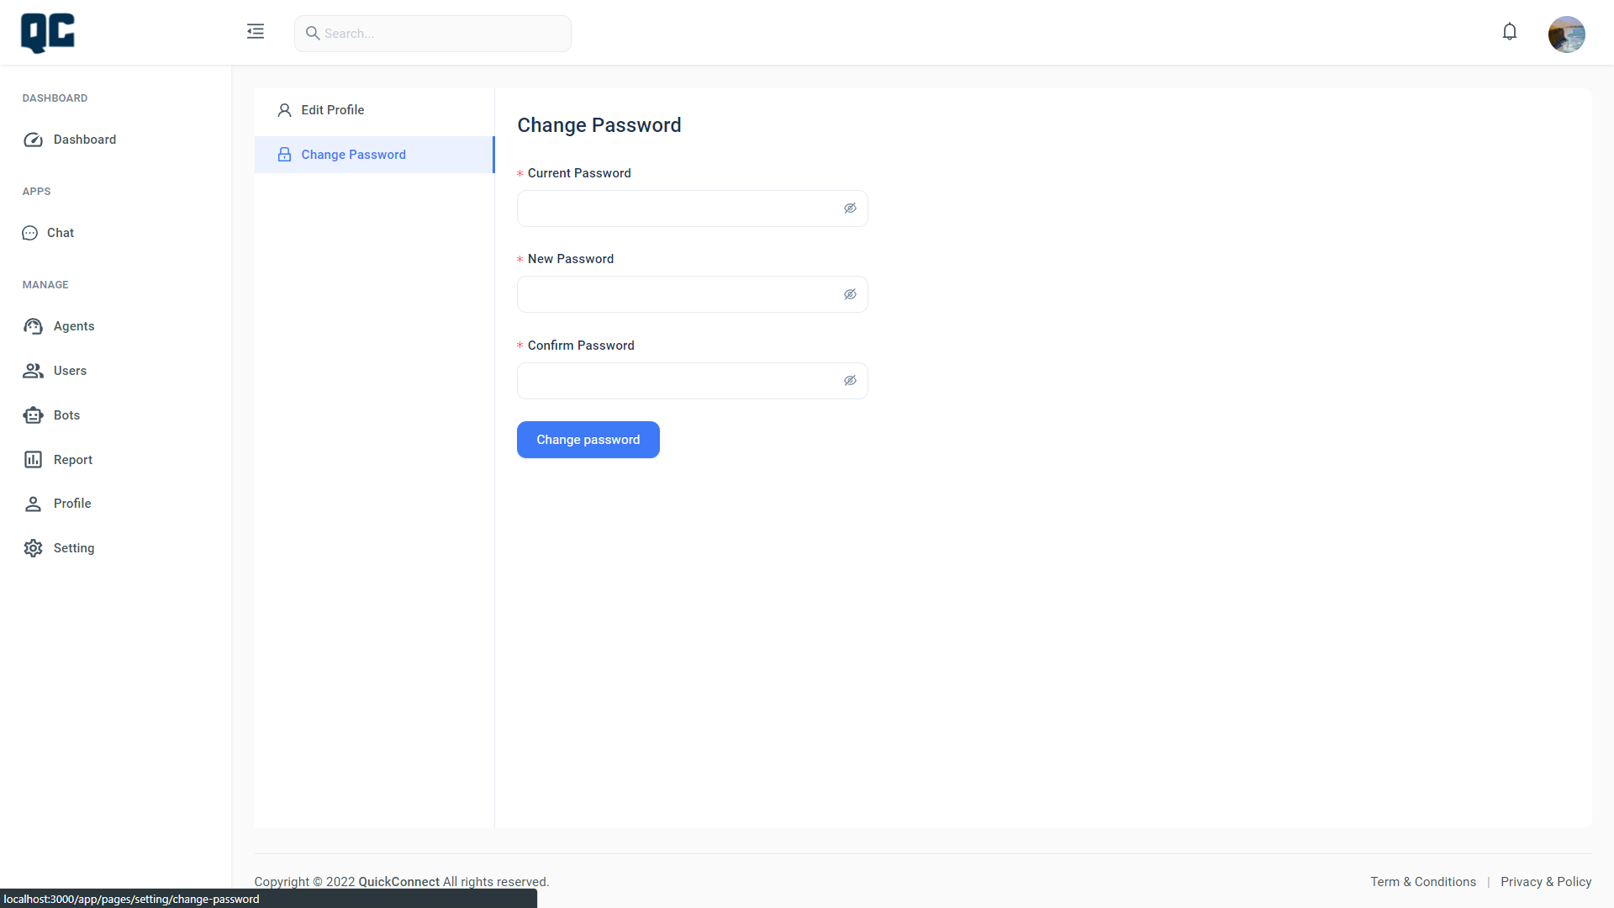
Change Password:-

Slide 50
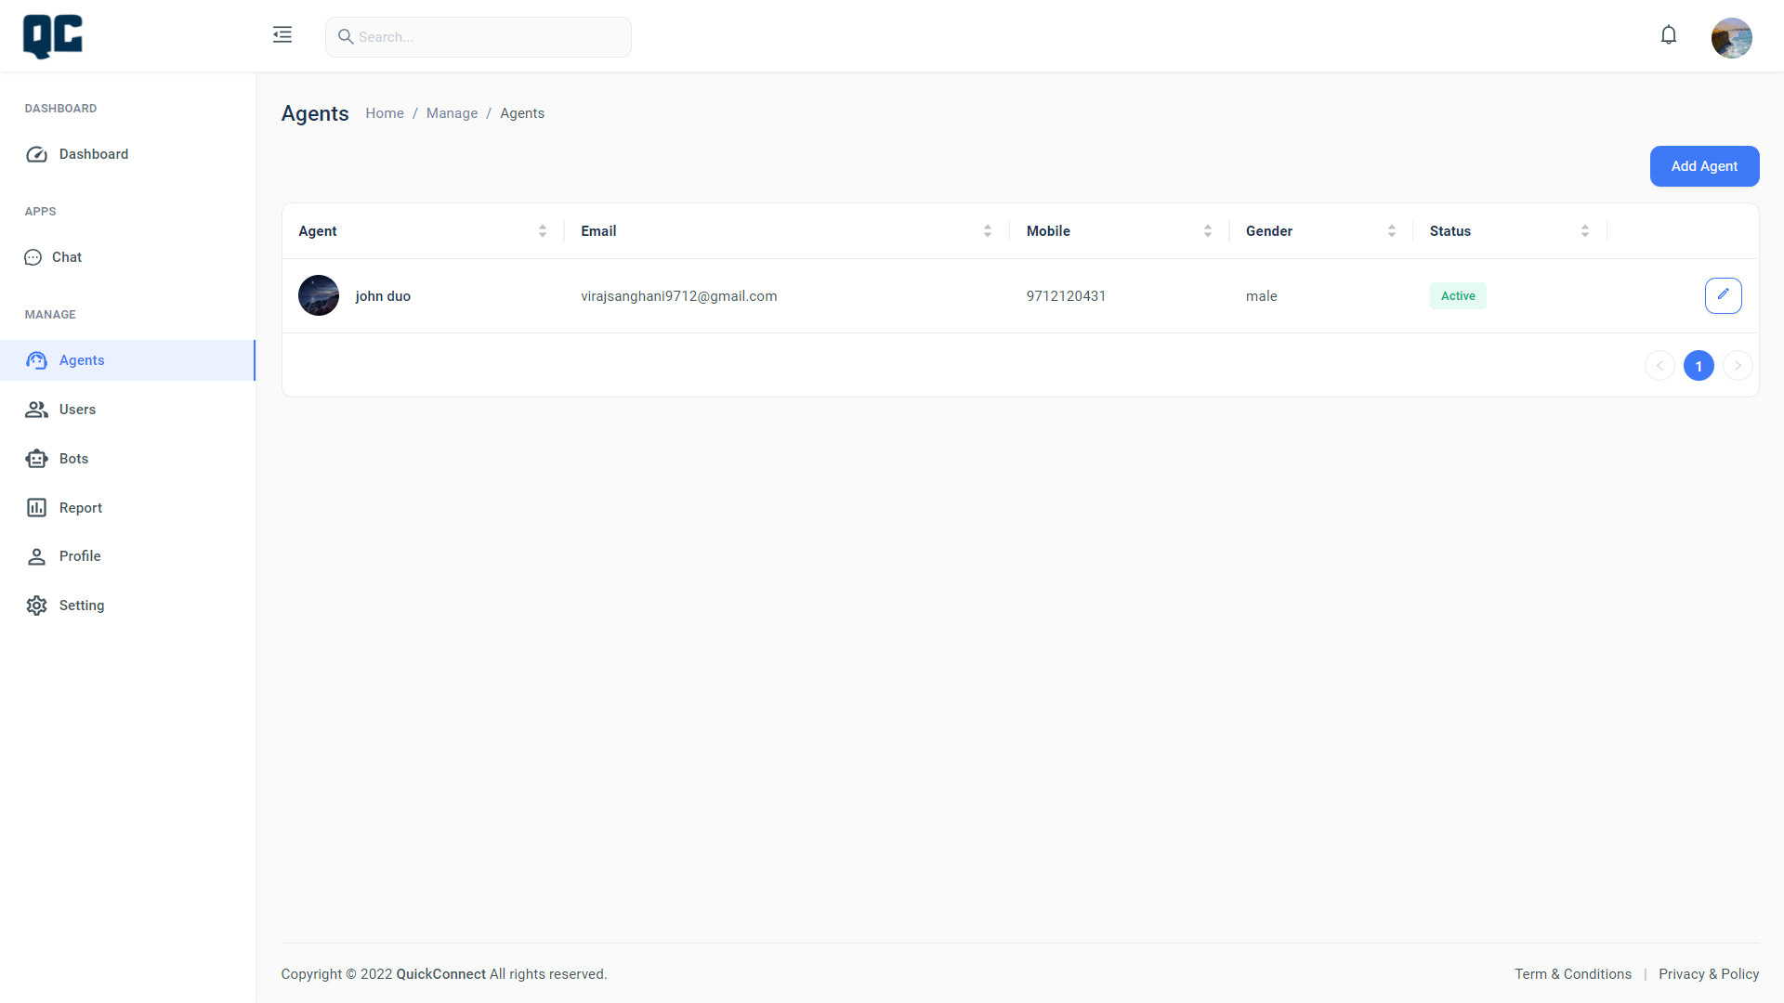
Agent:-

Slide 51
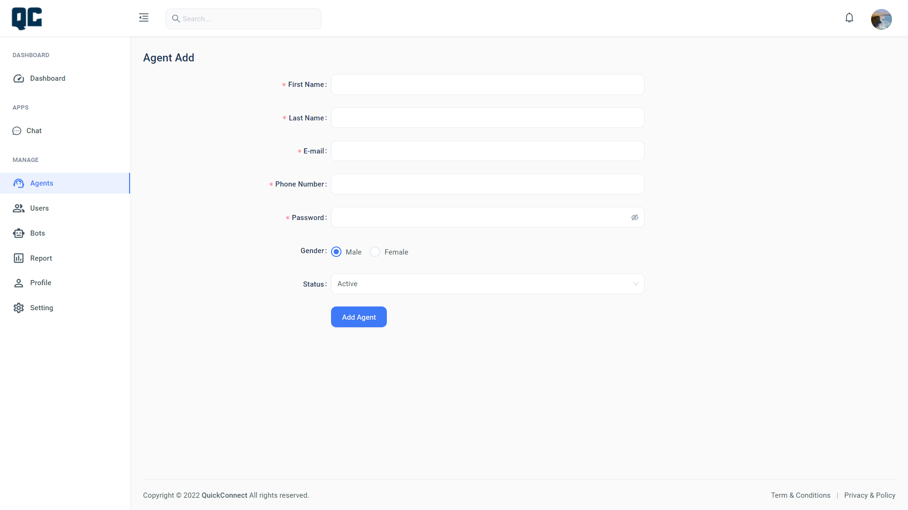
Agent Add:-

Slide 52
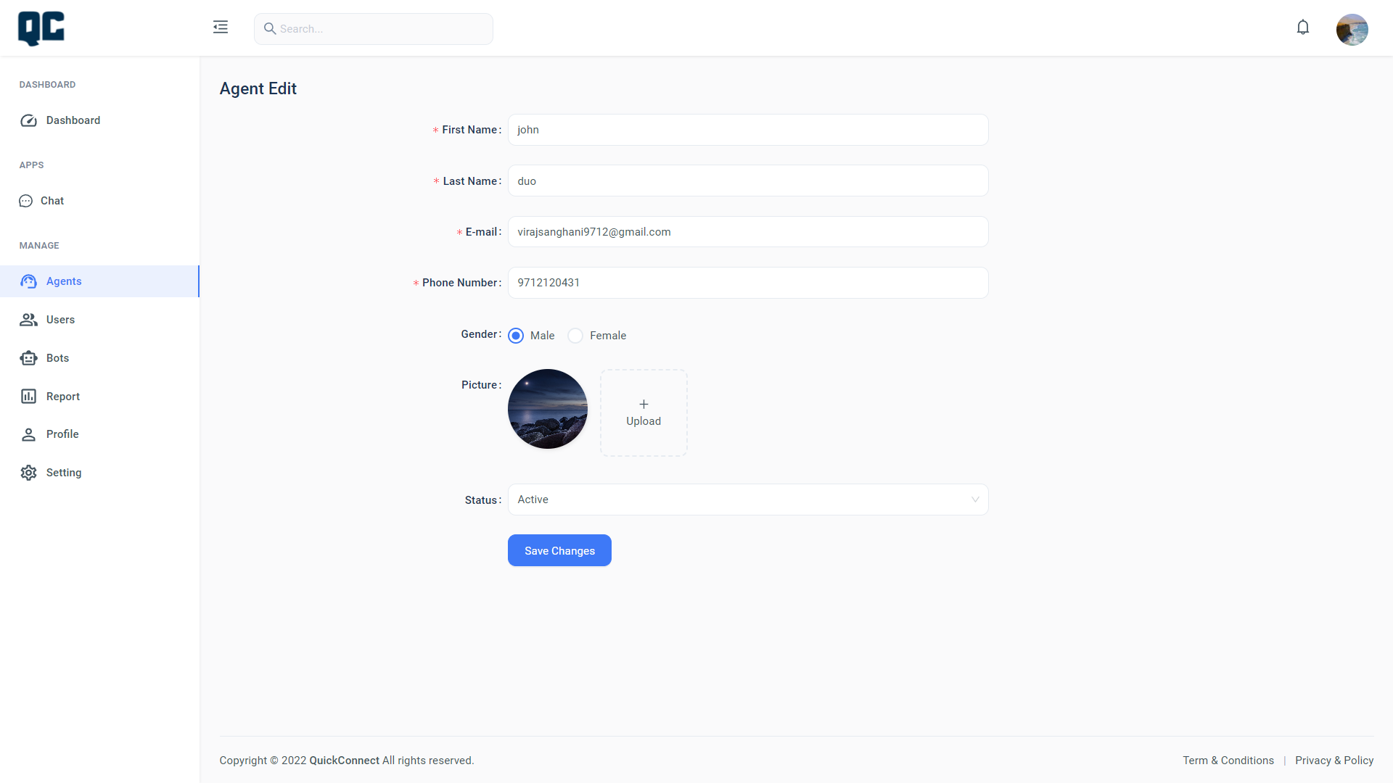
Agent Edit Profile:-

Slide 53
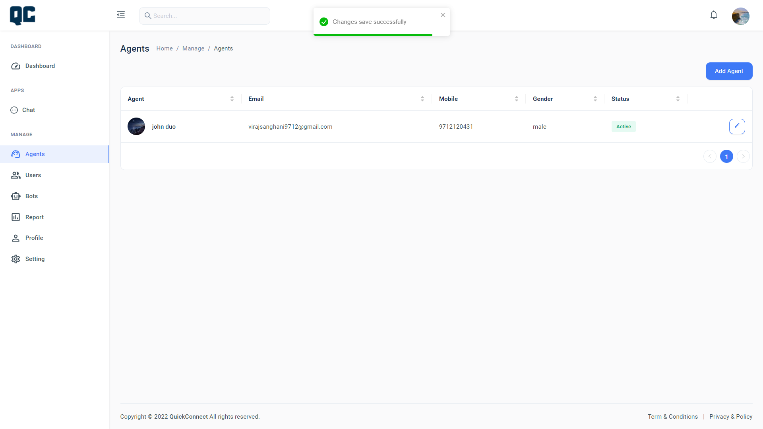
Agent Save Profile:-

Slide 54
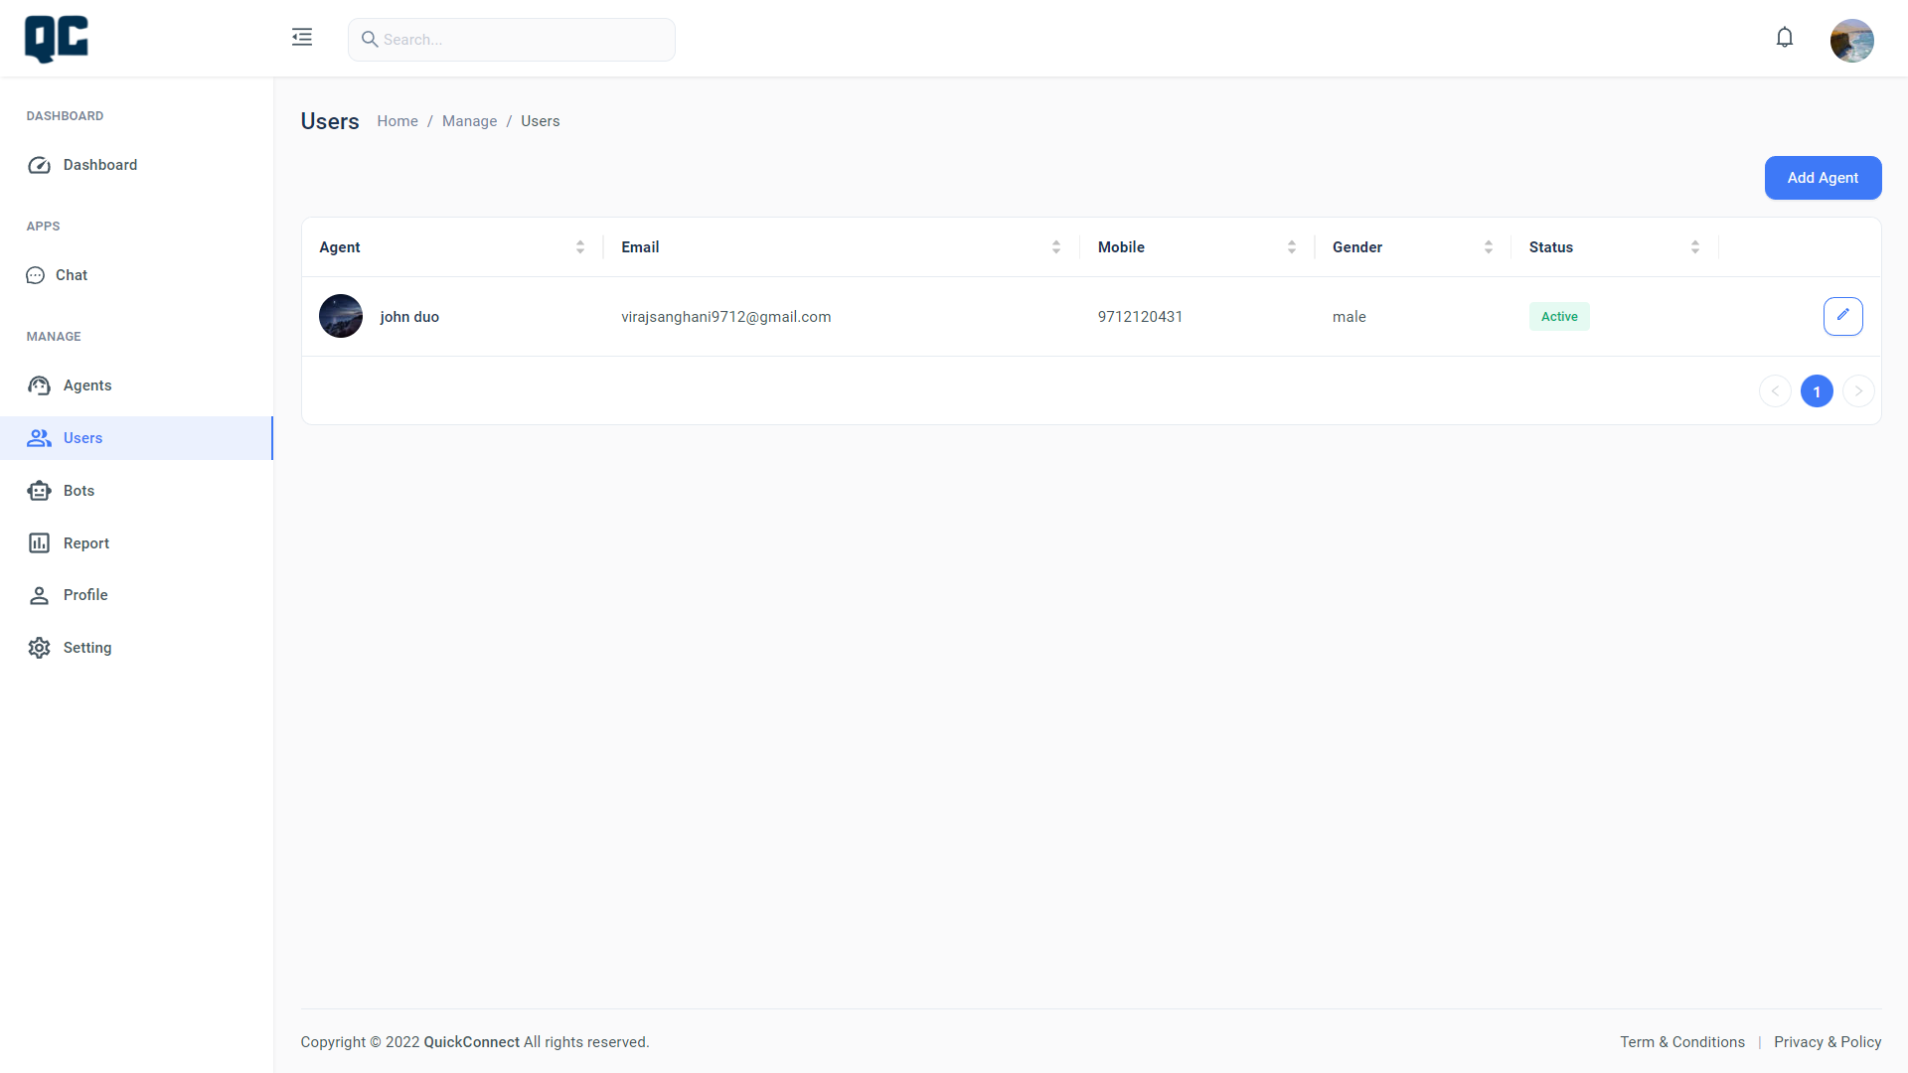
User:-

Slide 55
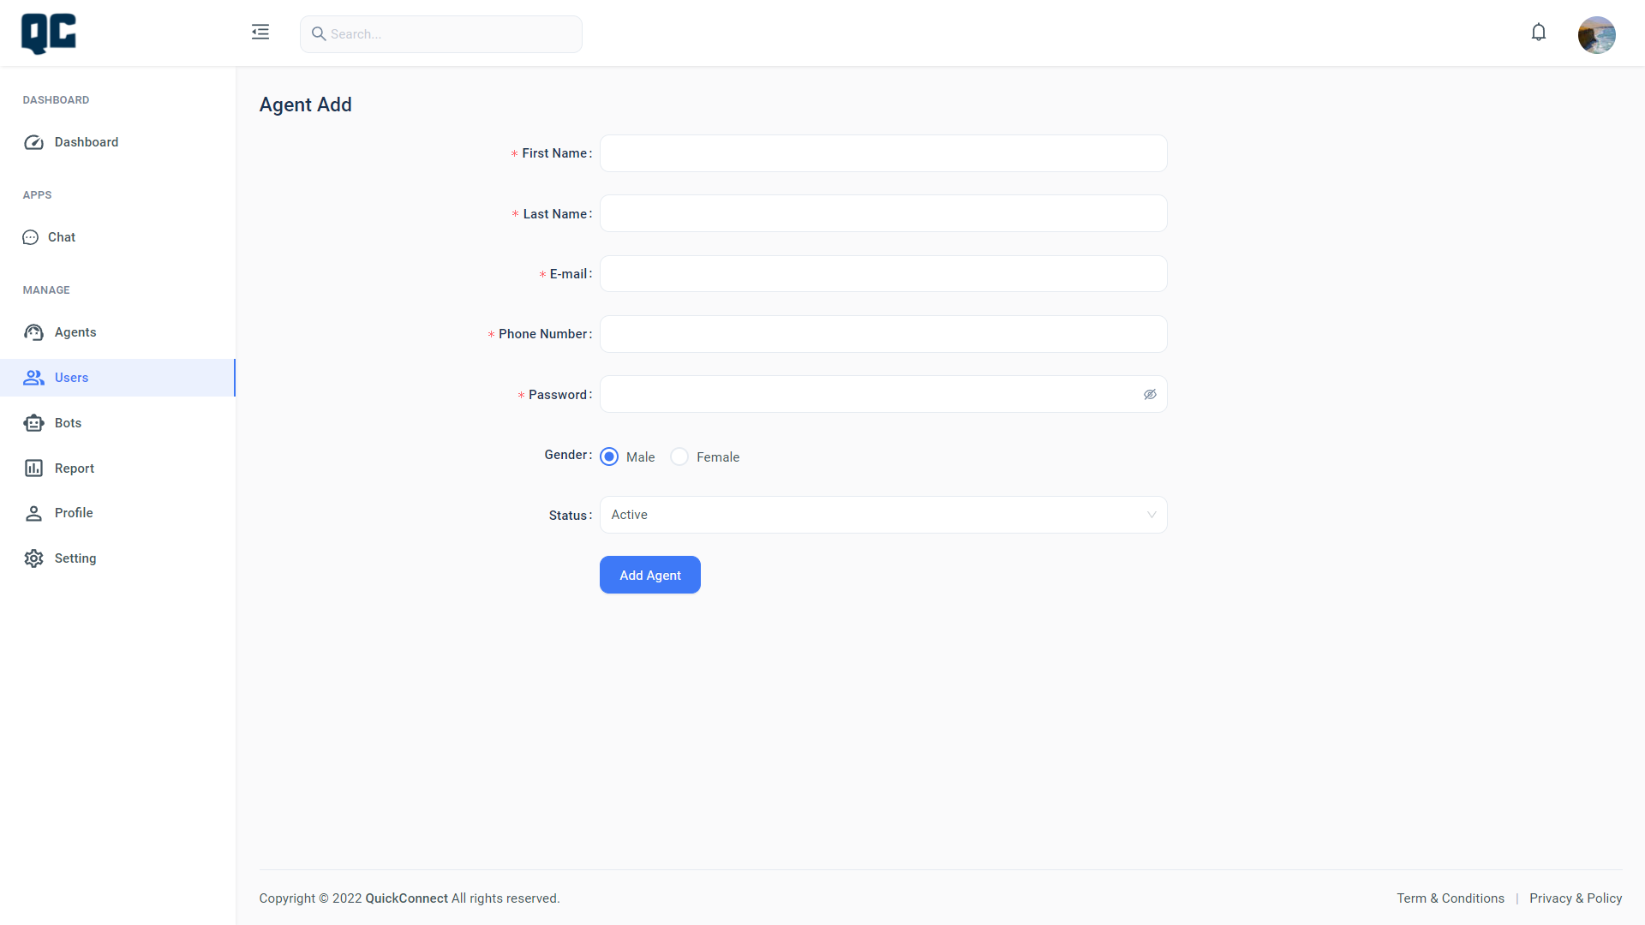
Users can add Agent:-

Slide 56

Users can Edit Agent:-

Slide 57
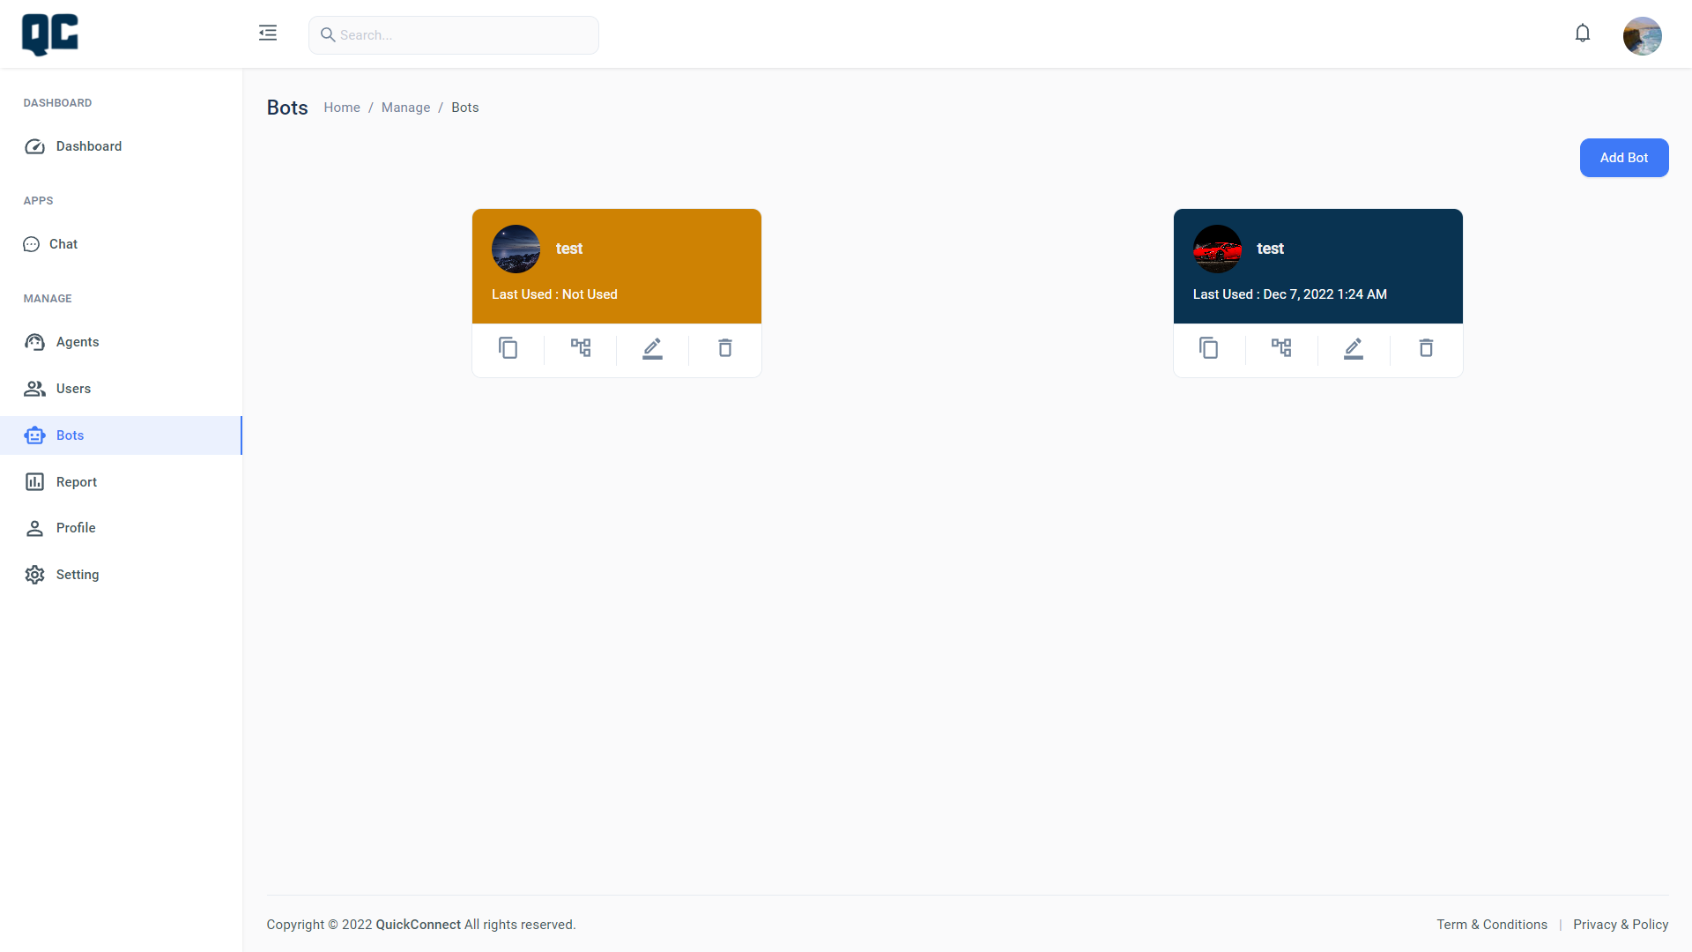
Bot:-

Slide 58
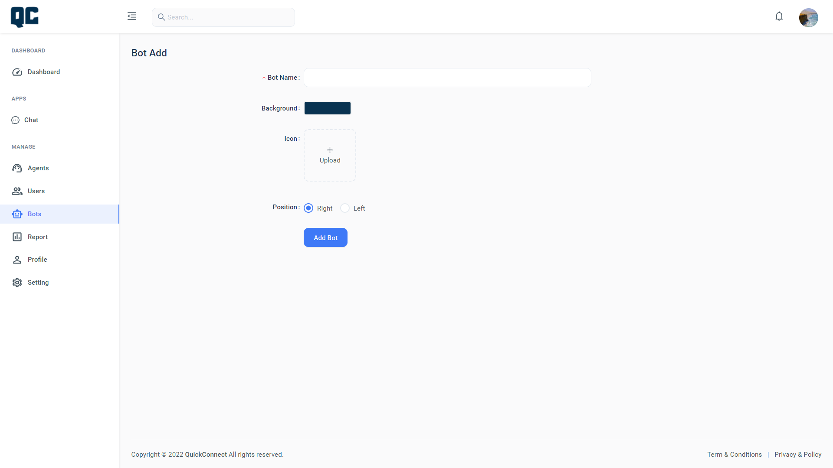
Add Bot:-

Slide 59
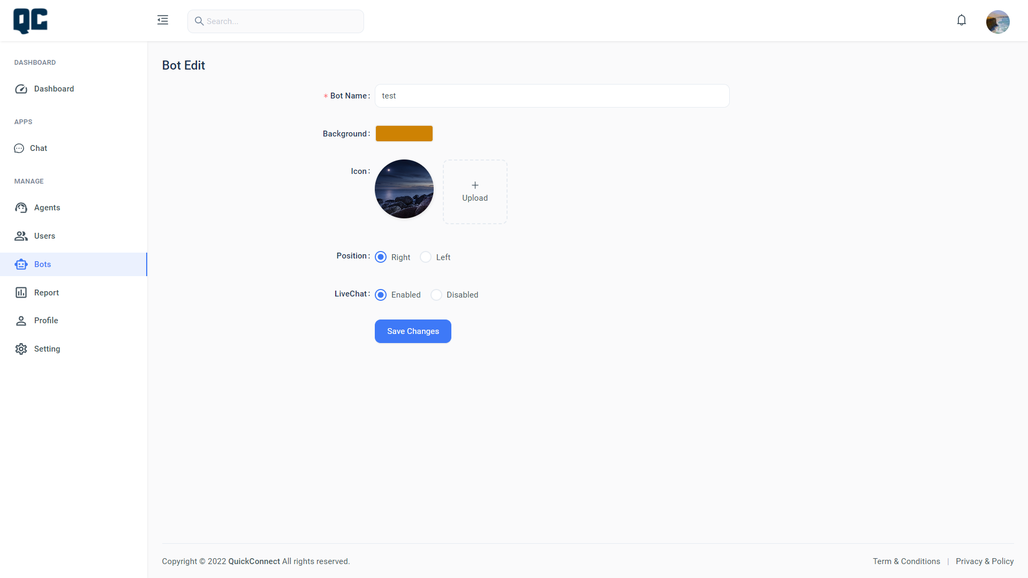
Edit Bot:-

Slide 60
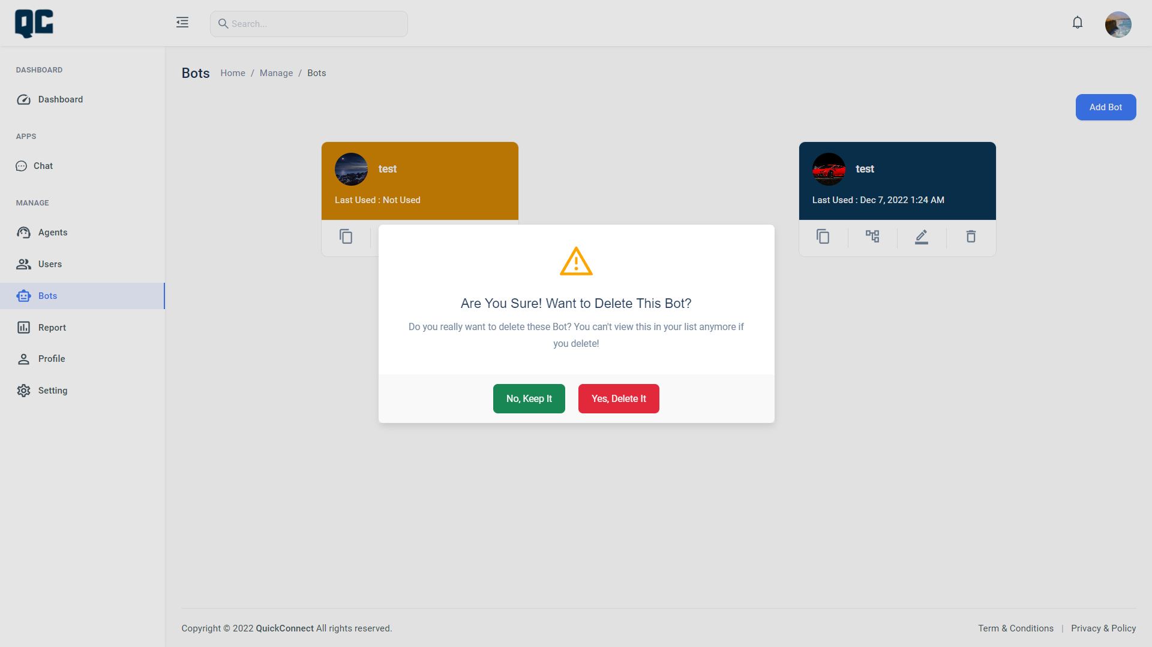
Delete Bot:-

Slide 61
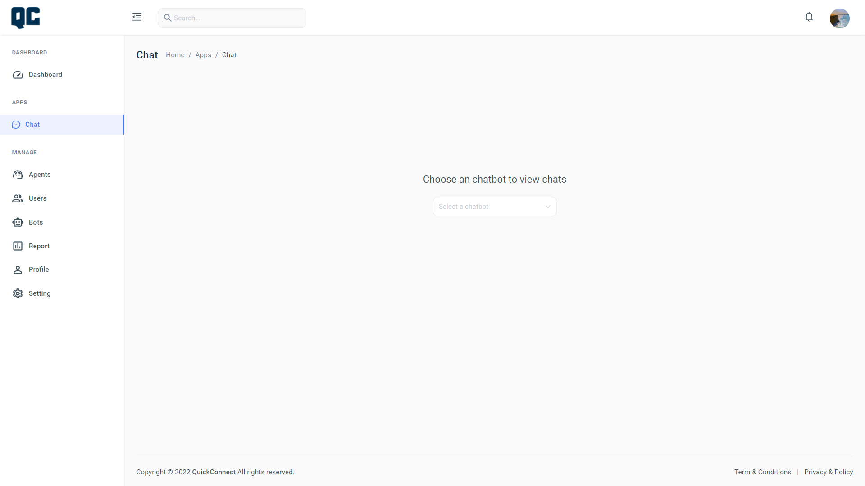
Choose ChatBot:-

Slide 62
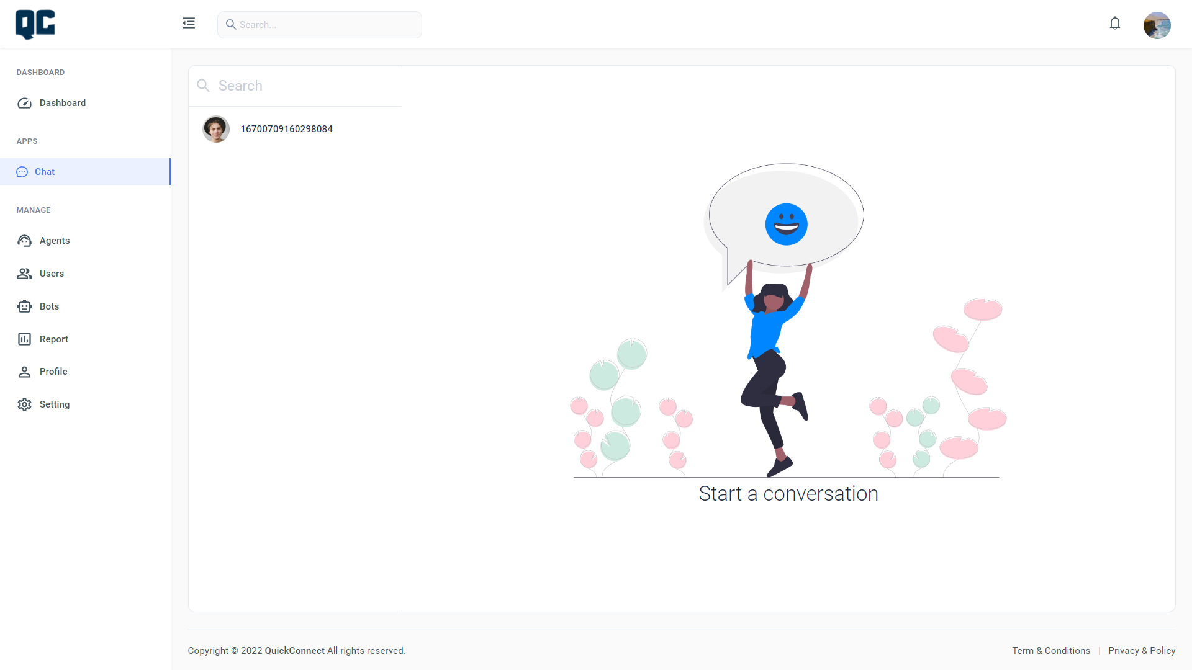
Show Chat:-

Slide 63
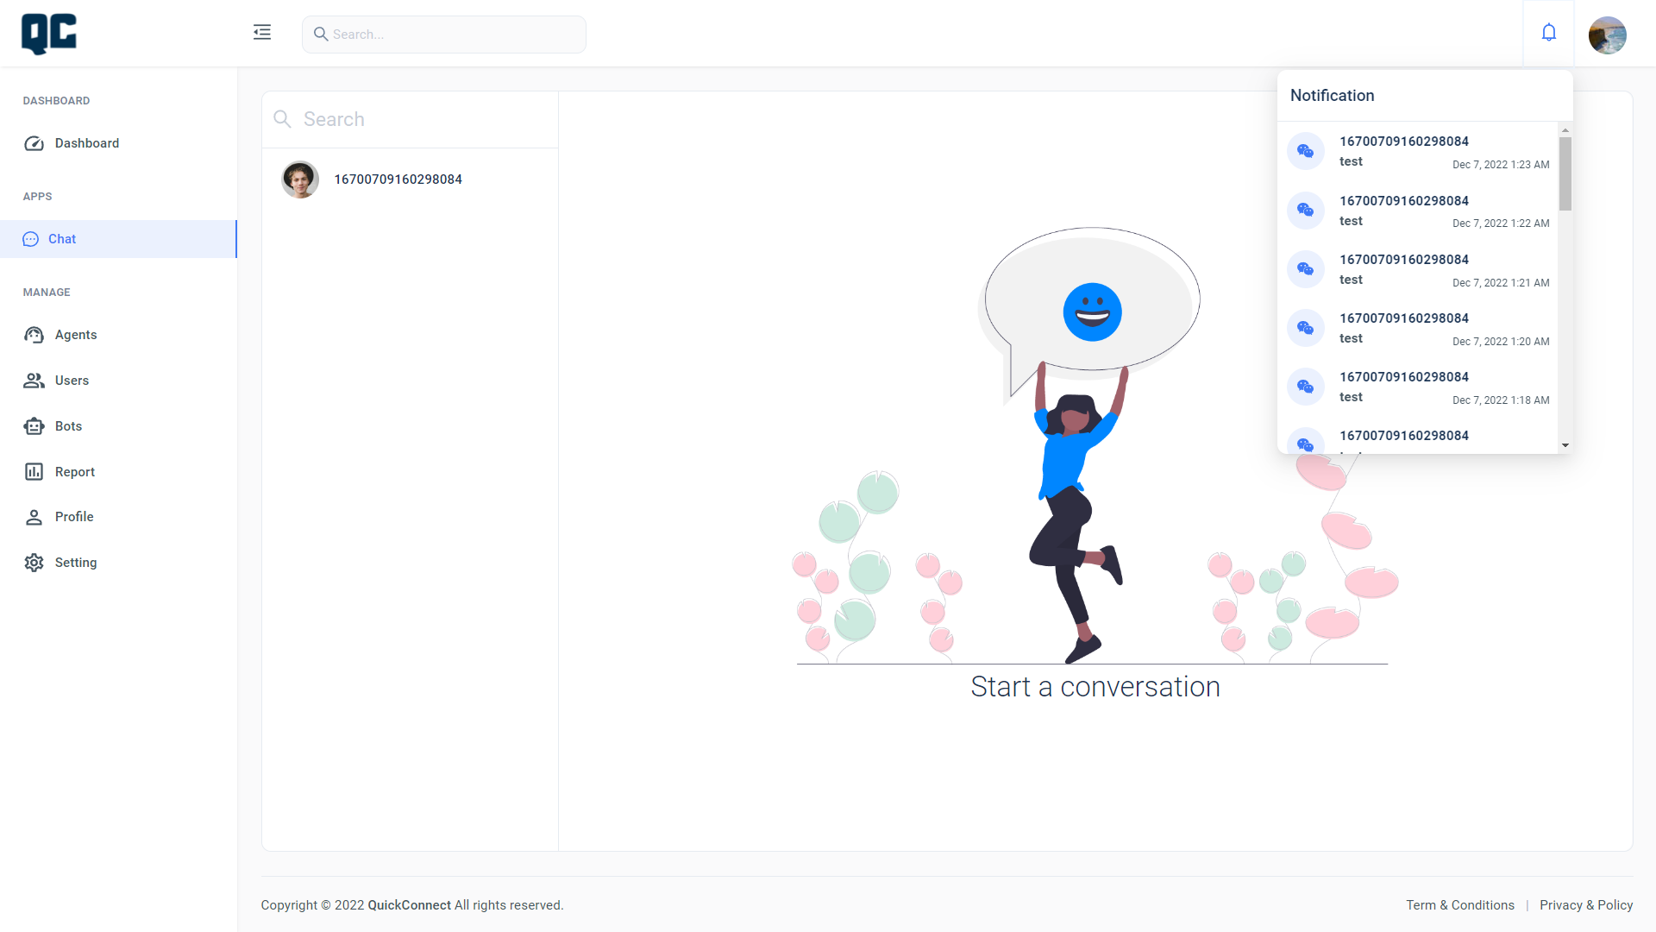
Notification Chat:-

Slide 64
Choose ChatBot:-

Slide 65
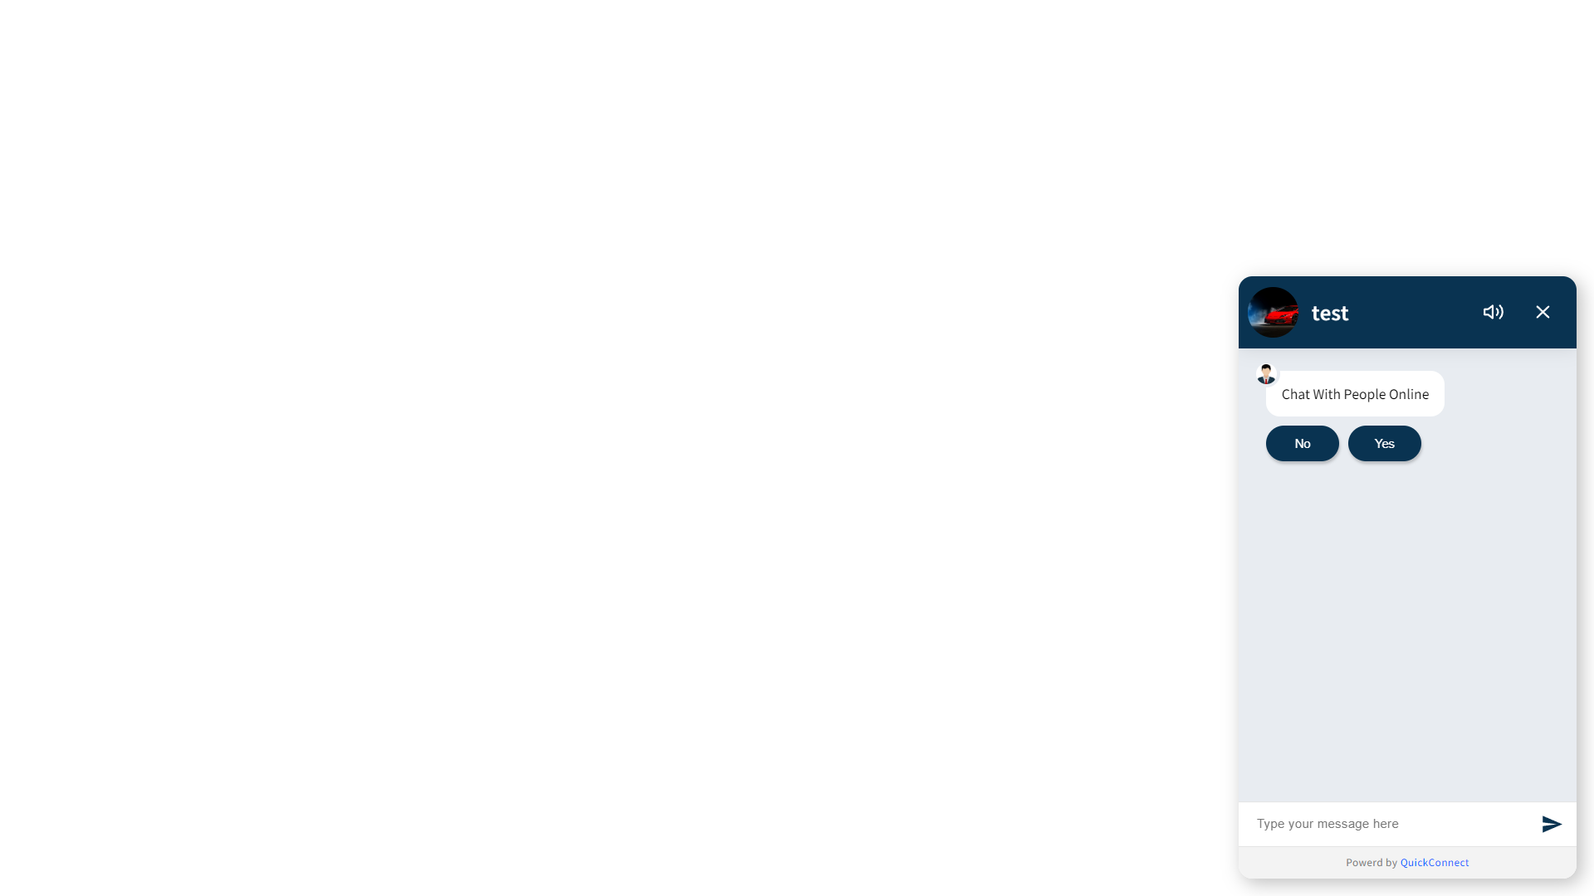
Live Chat With Agent:-

Slide 66
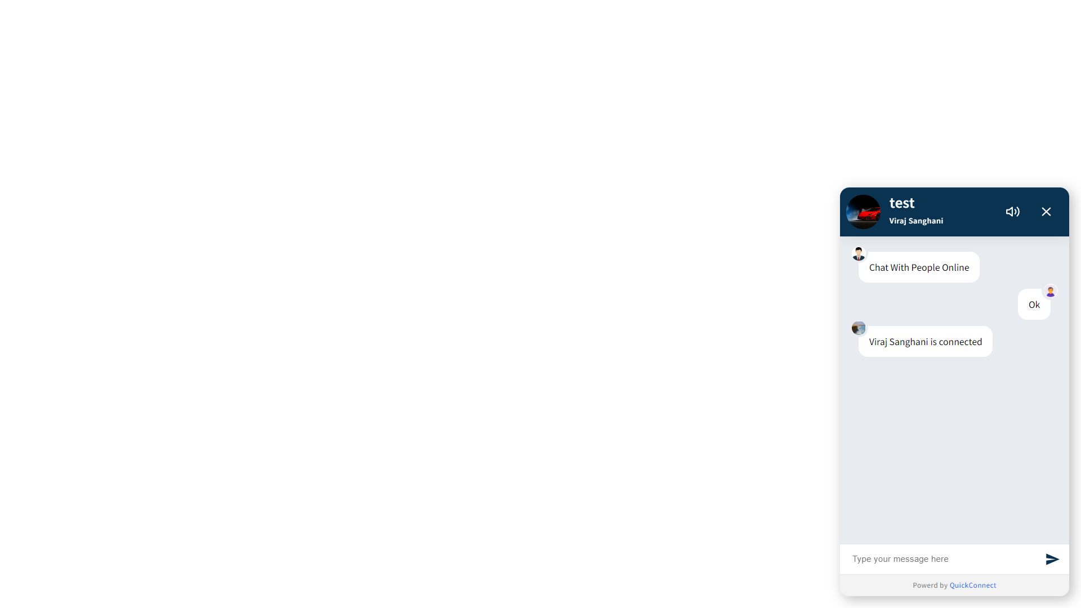
Agent Connected:-

Slide 67

Logo ChatBot:-

Slide 68
Thank You

